Slide 1






ALN and Inclusion
Discovering the voice of the child
Heather Melton
Specialist Teacher

Slide 2

Why is the voice of the child important?
Children are central to everything that we do.
We want to nurture independent citizens for the future.
To do this we need to put the needs of the young person at the centre of what we do

Slide 3

If we don’t nurture independent learners and citizens how are our young people going to cope in the future.
How do children feel? What is important to them.

Slide 4
As educators/parents how do we measure our success?
We measure our success because we are no longer needed. We have upskilled our children
What drives us as people? When we learn to read we aren’t doing it for the skill of reading
Therefore it’s important to know what is important to the child to know how we can best support them.

Slide 5
EASY/EASIER

Slide 6
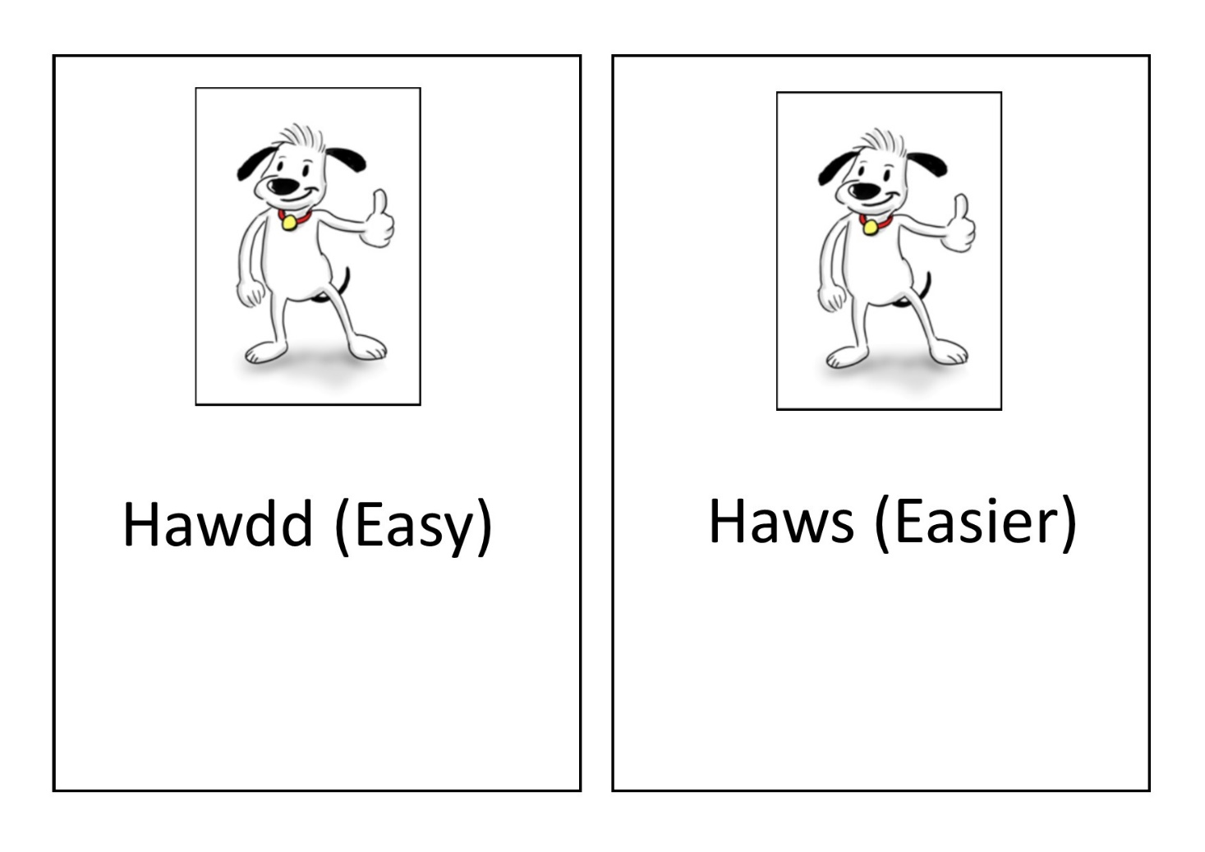

Slide 8
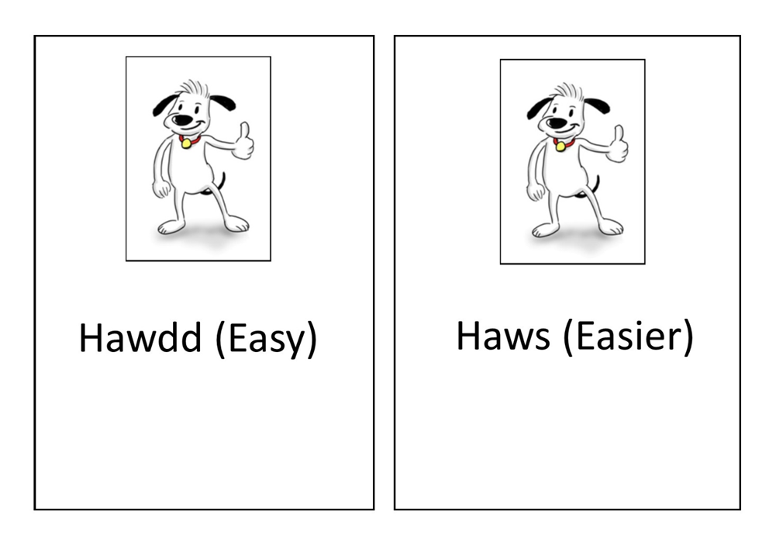

Slide 9
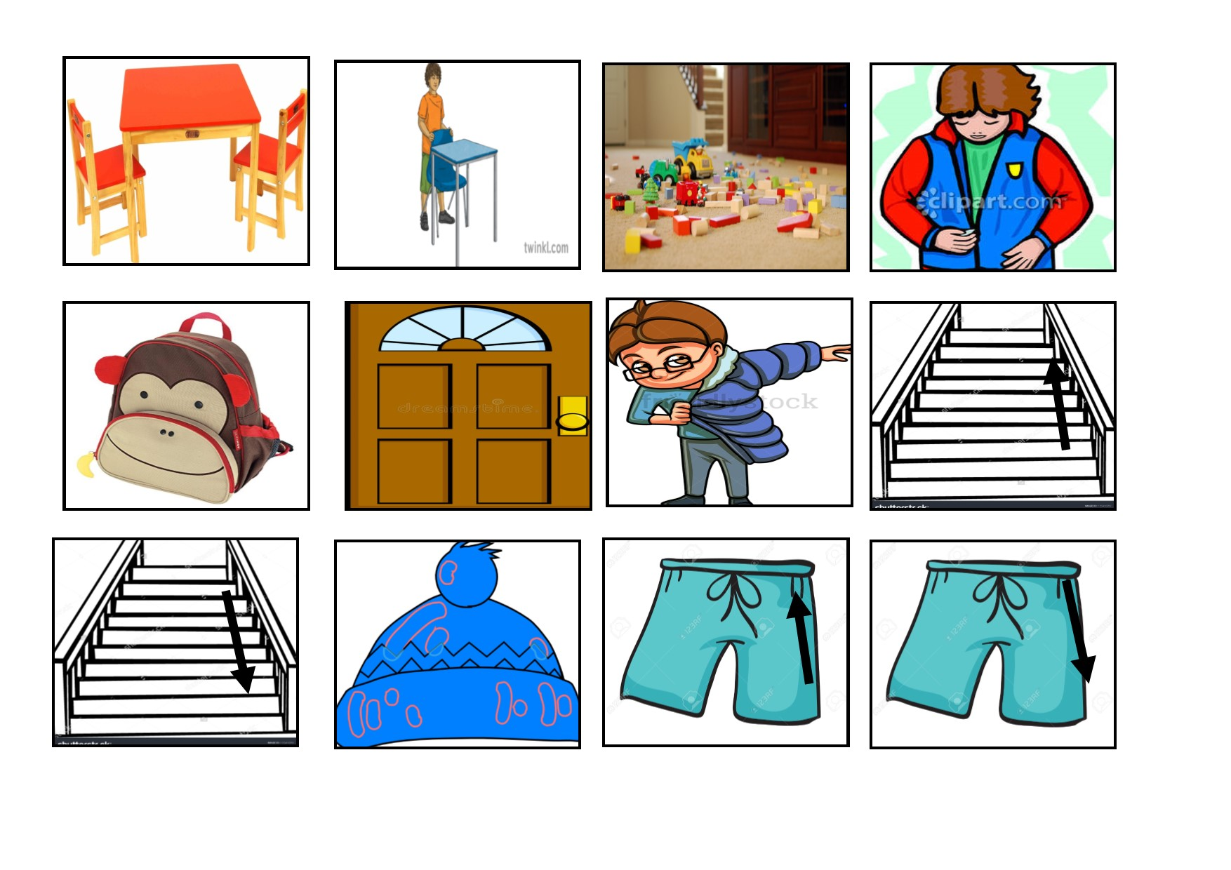

Slide 10
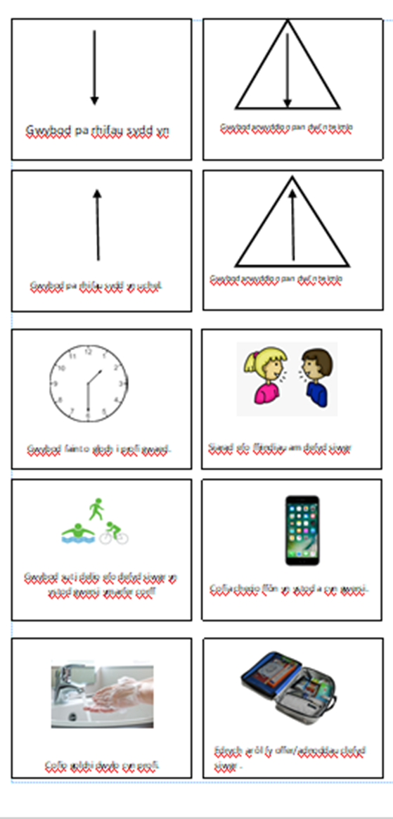

Slide 11
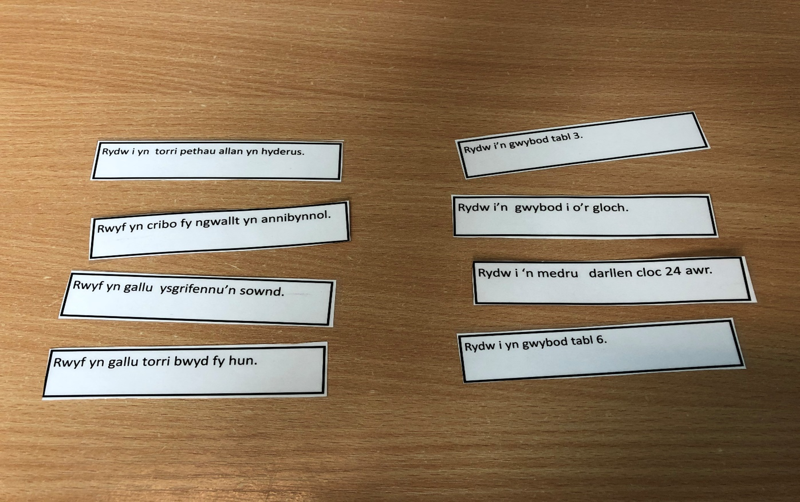

Slide 12


Slide 15


