Slide 1






ALN Training
Ellen Jones ellenjones@gwynedd.llyw.cymru
Put your computer on mute please.

Slide 2
AGENDA
Presenting important messages from the ALN Code
Introduce the 'Provision Map' document and processes for using it
Presenting the new referral process for additional provision
One page profile and the IDP Digital System
Effective visual resources at the level of Universal Provision and Targeted Universal Provision

Slide 3
ALN Draft Code December 2018
What will change?
How will the Act affect the way you work?
Notes:
Disodli’r system presennol sydd dros 30 mlynedd ac yn anaddas i’r diben rŵan
Cyfnod ymgynghori wedi dod i ben diwedd Mawrth – casglu ac ymateb i’r ymatebion.
Cod drafft terfynol yn cael ei chyhoeddi Rhagfyr 2019 – os na fydd rhywbeth cyfreithiol mawr wedi codi o’r ymgynghoriad
Dim ‘cod ymarfer’ fel yr un presennol
Does dim angen gôr boeni am y newidiadau – ALl yn cyd weithio ac yn arwain drwy’r newidiadau
3

Slide 4

Terminology
Introducing the term
'Additional Learning Needs'
ALN
Notes:
O dan y Ddeddf, disodlir y term AAA ac anawsterau dysgu neu anableddau, a defnyddir y term newydd, ADY.
Term AAA – yn cynnwys SIY, MAT, Meddygol
4

Slide 5
The Definition of ALN
Quote from the draft code:
‘It is whether the individual, when of compulsory school age, is, or would be if no Additional Learning Provision were made, likely to have:
A significantly greater difficulty in learning than the majority of others of the same age , or
A disability (within the Equality Act 2010)which prevents or hinders them from making use of facilities for education or training of a kind generally provided for others of the same age in mainstream maintained schools.’(7.13 Draft Code)
The second criterion is also the same as that for older children, namely whether the learning difficulty or disability calls for ALP (7.14)’
Notes:
O dan y Ddeddf, disodlir y term AAA ac anawsterau dysgu neu anableddau, a defnyddir y term newydd, ADY.
Term AAA – yn cynnwys SIY, MAT, Meddygol
5

Slide 6
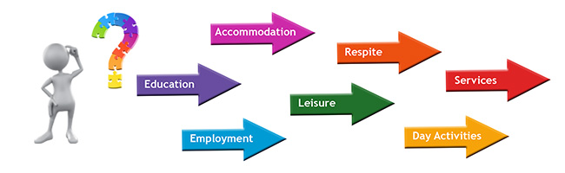
0-25 age range
A single legislative system to support children and young people with ALN who are 0 to 25 years old.
This replaces the current separate systems that supports the early years, schools and post-mandatory education.
Notes:
6

Slide 7


One Plan
The following is superseded:
Action in the early years (play plan)
Action in the early years and more by means of individual development plans 'in the school' (play plan)
Statement
The Act creates a single statutory plan - an Individual development plan (IDP) and replaces the range of statutory and non-statutory plans that currently exist for children
Notes:
Mae’n annog asiantaethau i gydweithredu a rhannu gwybodaeth, sy’n hanfodol er mwyn sicrhau y nodir anghenion yn gynnar.
Bydd rolau statudol megis y Swyddog Arweiniol Clinigol Dynodedig Addysg (DECLO) a’r swyddog arweinyddol blynyddoedd cynnar yn anelu at esmwytho cydweithrediad a threfniadau pontio.
Dweud fy stori un waith
7

Slide 8
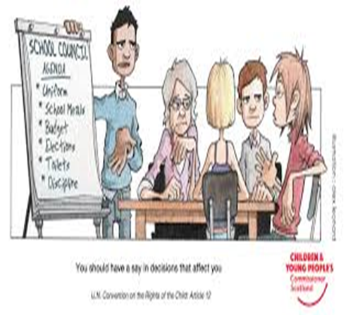
Who will contribute to the IDP?
The child
Parents / Guardians
Key workers within an Early Years placement
External services (Health / care)
Notes:
Reviews will focus on the individual, and pupils and their families will be supported to contribute to plans, outcomes and future provision in order to satisfy need.
8

Slide 9
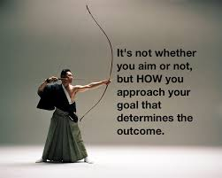

Outcomes
The IDP will focus on the provision that ensures real outcomes
The method of target setting will change. Our focus will be on person-centred outcomes.
Notes:
Deilliannau sydd yn sicrhau bod plentyn yn cyflawni ei botensial yn llawn.
9

Slide 10

Reducing conflict
Where there is disagreement about an Individual Development Plan or the provisions within it, the emphasis will be on considering the matter and resolving it on the most local level possible.
Notes:
10

Slide 11

Right to Appeal
Unless disagreement about the content of the IDP or the additional learning provision on a local level can be resolved, the Act ensures that children and young people (and their carers / parents in the case of those under 16 years old) have the right to appeal to a tribunal.
Notes:
ALl fydd yn gyfrifol – deddf ADY
Lleoliadau yn gyfrifol – deddf cydraddoldeb 2010
11

Slide 12

A bilingual system
Every service must consider whether a pupil requires a Welsh-medium additional learning needs provision.
Every reasonable step must be taken to ensure that the needs of the pupil are met through the medium of Welsh if he/she so wishes.
Notes:
12

Slide 13
Important messages from the ALN Draft Code, December 2019
It does not state that the role of the ALNCo is required in Early Years settings. However, 'National Minimum Standards for regulated childcare – standard 4' (Meeting Individual Needs) states the need to have a designated person within the setting.
It is not necessary to get a parent's consent to refer a child to the Authority's attention.
Statutory role of the ALN Leader - Source of Information for education – Ellen Jones
Statutory role of the DECLO – Source of information for health: Wen Hayton
Notes:
Replacing the current system that is over 30 years old and is now not fit for purpose
Consultation period expired at the end of March - collect and respond to the responses.
The final draft code will be published in December 2019 - if no major legal issue is raised in the consultation
Not a 'code of practice' as the current one.
No need to worry too much about the amendments - LA will work with us and guide us through the changes
13

Slide 14
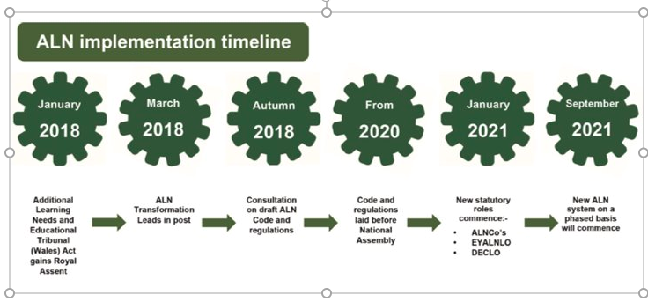
Notes:
Replacing the current system that is over 30 years old and is now not fit for purpose
Consultation period expired at the end of March - collect and respond to the responses.
The final draft code will be published in December 2019 - if no major legal issue is raised in the consultation
Not a 'code of practice' as the current one.
No need to worry too much about the amendments - LA will work with us and guide us through the changes
14

Slide 15

Any Questions?
Use the chat option please.
Notes:
15

Slide 16
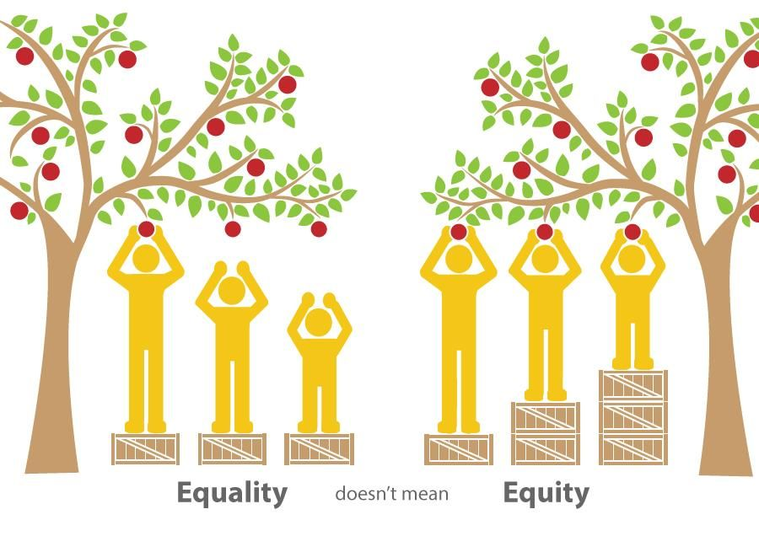
What is inclusion?
One of the principles of the ALN Code is inclusive education where, wherever practicable, children are supported to take full advantage of mainstream education and the whole setting seeks to meet the needs of a child with ALN. The ALN Code provides guidance on the process of assessing and deciding whether a child has ALN.
Notes:
Adnabod cryfderau a meysydd sydd angen cefnogaeth. Goresgyn unrhyw rhwystr drwy; addasiadau, darparu adnoddau pwrpasol a / neu darparu cefnogaeth amserol
Bod yn wyliadwrus nac ydym yn gôr label plant – gallu cael effaith negyddol ar ddeilliannau

Slide 17

Early Years Provision Map
Ma

Slide 18
Provision Map Model
Additional Learning Provision
Individual Development Plan (IDP)
The LA's Responsibility
Universal Provision
Targeted Universal Provision
The statutory timetable must be adhered to when starting this step –
Notes:
Adnabod cryfderau a meysydd sydd angen cefnogaeth. Goresgyn unrhyw rhwystr drwy; addasiadau, darparu adnoddau pwrpasol a / neu darparu cefnogaeth amserol
Bod yn wyliadwrus nac ydym yn gôr label plant – gallu cael effaith negyddol ar ddeilliannau
18

Slide 19
Universal Provision
Universal provision supports all children, i.e. the whole setting and ensures that every child has the appropriate opportunities to make progress.
This level includes workforce development, access to appropriate information, reasonable adjustments, creating environments that are communication -friendly, and whole setting intervention methods.
Notes:
Datblygu’r gweithlu – mynediad at wybodaeth briodol, creu amgylcheddau cyfeillgar i gyfathrebu a dulliau ymyrraeth dosbarth / ystafell gyfan
E.E: amserlen weledol, makaton, ystafell wedi’i drefnu’n ofalus,
DDASIADAU RHESYMOL
19

Slide 20
Targeted Universal provision
.
Based on evidence of a child's attainment and/or progress, settings should support their individual needs. chapter 7 of the ALN Draft Code states that targeting children “is a fundamental element of quality - but normal teaching.”
The `National Minimum Standards’ states that the registered person is responsible for ensuring that:
4.1 they can demonstrate that they can meet the assessed needs of children placed with them.
4.2 they (or their staff) have the skills and experience needed to plan for and meet a child’s individual needs and preferences.
Notes:
Dull ymateb graddoledig. Cam i dargedu plant ond ddim o rheidrwydd yn blant ADY.
20

Slide 21
Additional Learning Provision
Additional provision is defined in the Draft ALN Code (2018) as:
(1) “Additional learning provision” for a person aged three or over means
educational or training provision that is additional to, or different from, that made
generally for others of the same age in—
(a) mainstream maintained schools in Wales,
(b) mainstream institutions in the further education sector in Wales, or
(c) places in Wales at which nursery education is provided.
(2) “Additional learning provision "For a child aged under three means educational provision of any kind.
(3) In subsection (1), “nursery education” means education suitable for a child who has reached the age of three but is below compulsory school age.
Notes:
Iechyd a/ neu’r ALl fydd yn gyfrifol am DdY
21

Slide 22

Provision Map
Whose responsibility?
Following the wheel
1:Observing and Assessing
3:Providing
2:Planning
4:Reviewing
Local Authority
IDP
Early Years Settings
One page profile
Early Years Settings
Plans
IDP: Individual Development Plan
22

Slide 23
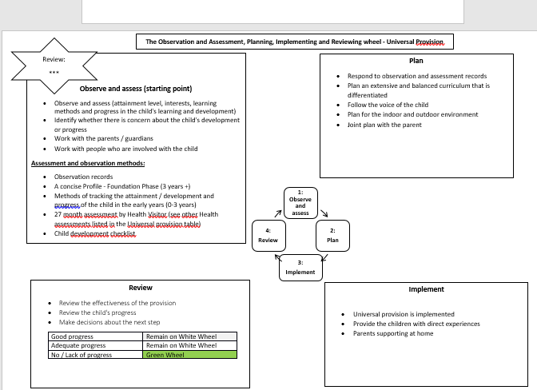


Universal Provision Wheel

Slide 24
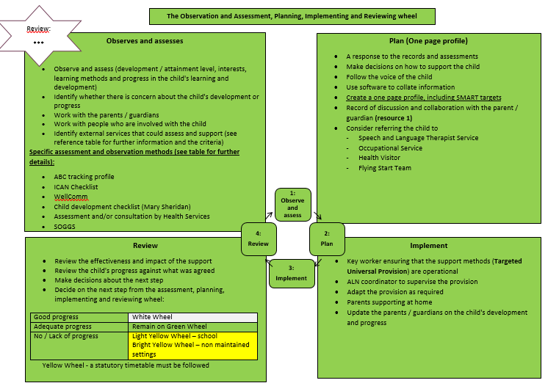
Targeted Universal Provision Wheel

Slide 25
Access to additional provision in the Early Years flow chart
Week 1-6
Share the decision with the parent and the services involved with the case
Step 1:
Draw the attention of the LA to the possibility that a child may have ALN
Step 2:
Gather evidence
(ALN criteria form)
Step 3a:
Small Moderation Panel to validate the decision (DALNC:8.9 - ask a psychologist)
No ALN
ALN
Week 7-12
Step 3b
Decide which service is likely to provide additional support / provision
Step 4: Draw up an AIDP
Step 5: Present the IDP to the attention of the Moderation Panel to validate the ALP
Step 6: Present the IDP to the parent / guardian and the services involved with the case

Slide 26
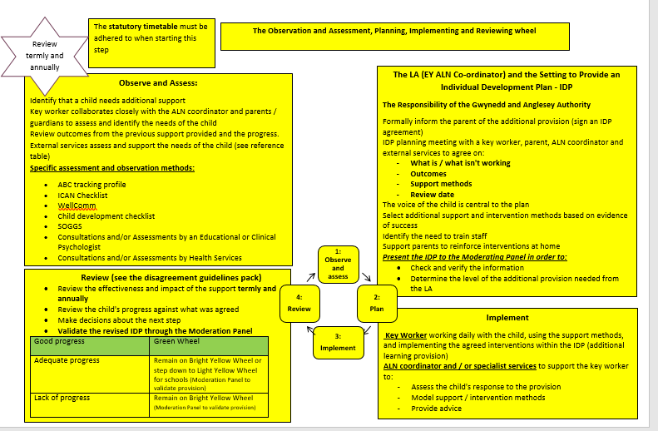
Additional Provision Wheel (Local Authority)
Ma

Slide 27

Supplementary document
Ma

Slide 28
Entry points when starting in a setting
A child may enter a setting at any tier within the provision map depending on the level of provision the child has received at home or at a previous setting.
Additional Learning Provision
Individual Development Plan (IDP)
The LA's Responsibility
Universal Provision
Targeted Universal Provision
C Entry Point
The statutory timetable must be adhered to when starting this step –
B Entry Point
A Entry Point

Slide 29
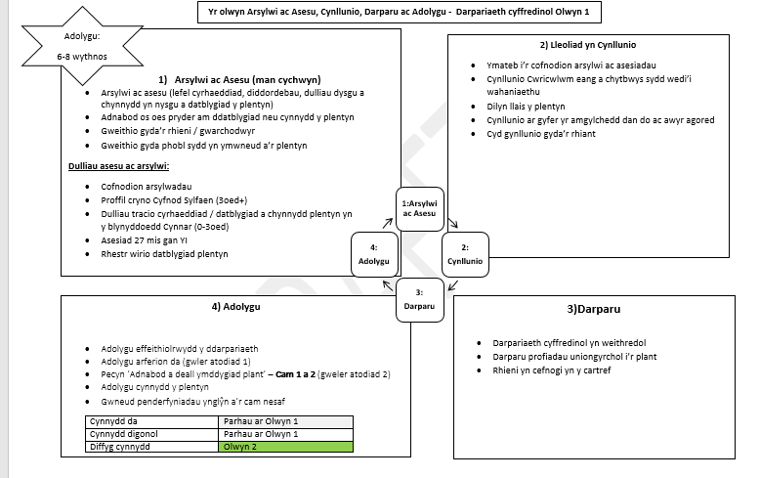
A Entry Level or starting Point
Ma
Access to the setting – Setting to talk with parent
Setting to operate on the Universal Provision layer (white wheel).
Teacher may consult at Universal provision level (situations / routines of concern) Record on Advisory Teacher record form
1:Observe and assess
3:Provide
4:Review
2:Plan

Slide 30

A Entry Level or starting Point
Observation and assessment methods have highlighted a concern (achievement or progress)
Setting to arrange an initial meeting with the parent / guardian. Share information and agree on actions
Record on F1
Complete F2
Complete or revise the Information sheet ready to create a one page profile
Share the pamphlet 'What is a one-page profile' with the parent / guardian and explain the process of how to receive an invitation to contribute to the one-page digital profile via e-mail. Explain that a 6 digit code will need to be received from the setting to register on the system. Share/discuss the guidance booklet.

Slide 31
Important information
F1:to remain in the setting adhering to the setting's data protection policy (Advisory Teacher will be aware that you have a child stepping onto the green level (targeted Universal Provision) as she receives an invitation to contribute to the One-page Profile).
F2: Email for the attention of the Authority Officer (Ellen Jones during interim) ellenjones@gwynedd.llyw.cymru. The form must be password protected Ff2Gwynedd

Slide 32
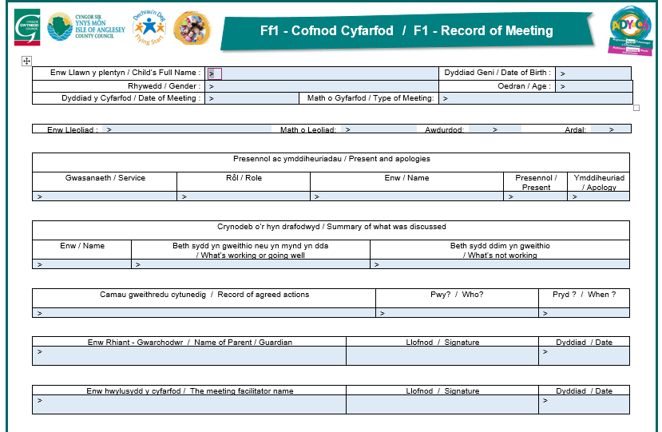
F1 – Meeting Record
Ma

Slide 33
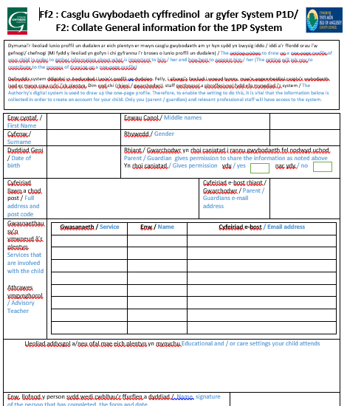
F2 – Collect Core Information

Slide 34
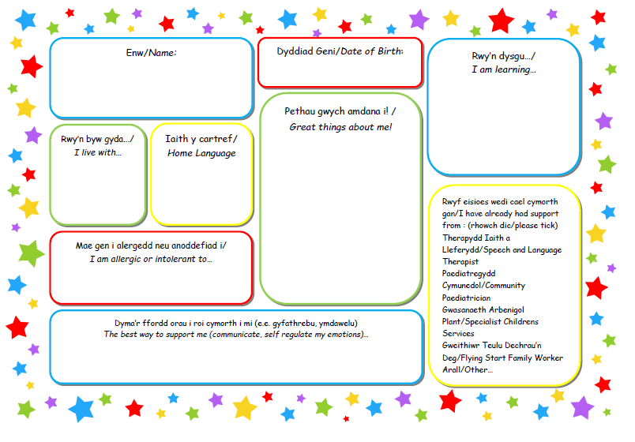
Complete or review information collection sheet

Slide 35
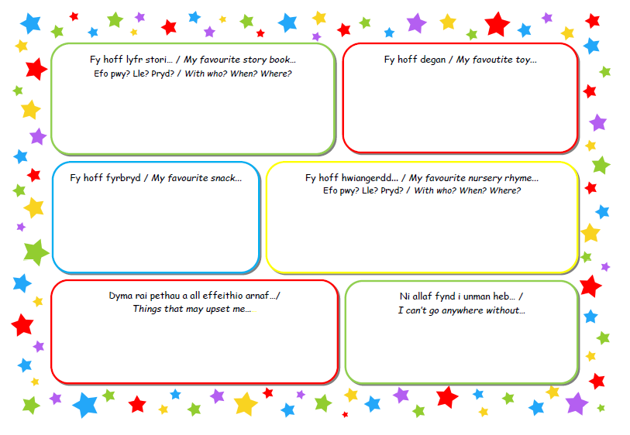

Slide 36

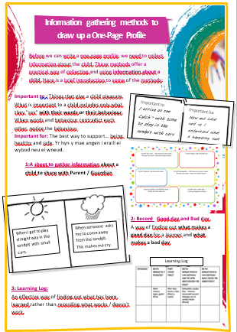
One Page Profile Leaflet for Parents / Guardian
Ma

Slide 37

Guidance booklet on how to receive an invitation to contribute to a One Page Profile

Slide 38
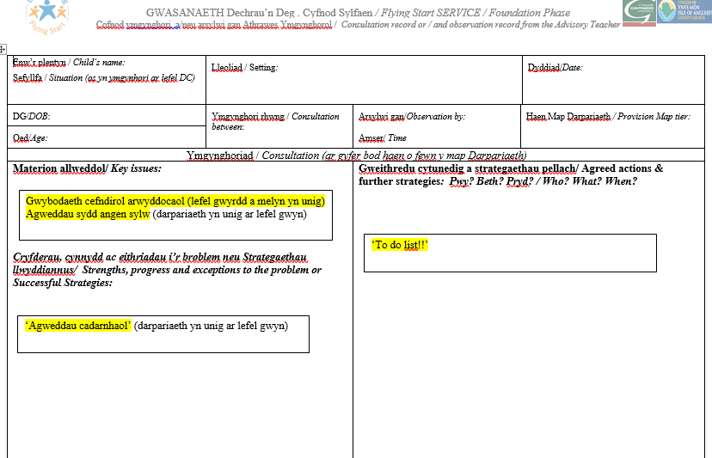
Advisory Teacher consultation recording form
Ma

Slide 39
B Entry level
Setting to arrange a meeting with the parent / guardian, leader /manager and any service involved with the child / family including previous setting before the child commenced at the setting.
Record on F1
Complete F2
Complete or revise the Information sheet ready to create a one page profile
Share the pamphlet 'What is a one-page profile' with the parent / guardian and explain the process of how to receive an invitation to contribute to the one-page digital profile via e-mail. Explain that a 6 digit code will need to be received from the setting to register on the system. Share/discuss the guidance booklet.

Slide 40
Important information
F1:to remain in the setting adhering to the setting's data protection policy (advisory teacher will be aware that you have a child stepping onto the green level (targeted Universal Provision) as she receives an invitation to contribute to the One-page Profile).
F2: Email for the attention of the Authority Officer (Ellen Jones during interim) ellenjones@gwynedd.llyw.cymru. The form must be password protected Ff2Gwynedd

Slide 41
C Entry Level
Children with profound needs
Setting to arrange a meeting with the parent / guardian, leader /manager, advisory teacher and any service involved with the child / family including previous setting before the child commenced at the setting
Share key information and agree on the actions Record on Form 1, this may include referring to the Early Years Panel for funding for extra pair of hands (see referral form on slide 43)
Complete F2 and the Information Gathering Leaflet
Share the 'What is a one-page profile ‘leaflet with the parent / guardian and explain the process of how to receive an invitation to contribute to the one-page digital profile via e-mail. Explain that a 6 digit code will need to be received from the setting to register on the system. Share/discuss the guidance booklet

Slide 42
Referral Arrangements for the Early Years Panel
A new Referral Form will need to be used. A copy has been attached and a copy can be downloaded from the Gwynedd and Anglesey ALN & I website
Please email the referral form and attachments to the email address below using the following password Cyfeirio2020 gweinyddolADYaCH@Gwynedd.llyw.cymru
Any queries relating to the referrals please email the above e-mail address or contact the EYALN Lead Officer Ellen Jones ellenjones@gwynedd.llyw.cymru
Last day for receiving new referrals: | Date of Early Years Panel: | Share decision with settings by:
12pm 25/1/21 | 1/2/21 | 8/2/21
12pm 3/3/21 | 10/3/21 | 17/3/21

Slide 43
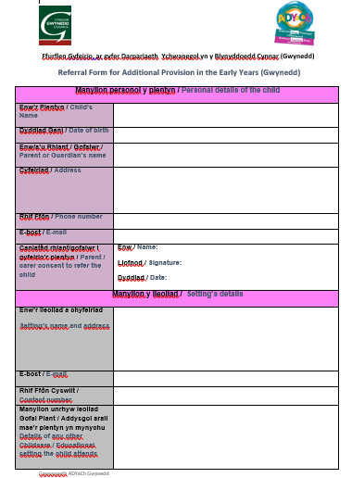
Referral Form

Slide 44
Important Points
When conducting an initial conversation with the parent (face-to-face or over the phone) it is important to ask sensitively whether the child is open to any other service or receives any additional support / provision. This will allow you to try to identify the child's starting point on the Provision Map Model as shown in the table below.
Not open to another service | Access point A Act on the Universal Provision tier | Talk with the parent
Open to another service e.g. Speech and Language | Access point B Act on the Targeted Universal Provision tier | Setting to arrange a meeting before the child commences to discuss what needs to be in place to support the child. Start drawing P1D.
Significant needs / open to several services | Access point c Act on the Additional Provision tier | Setting to arrange a meeting before the child commences to discuss what needs to be in place to support the child. Start drawing P1D and to agree if need to refer to the EY Panel

Slide 45
Processing the F2 Form
Ma
Setting to email the F2 to LA officer (Ellen – during interim) ellenjones@gwynedd.llyw.cymru
Officer to proces sthe data on the digital system
Officer to share invitations with people involved with the child including parents / guardians
People to accept their email (see guidelines) and contact LA officer (Ellen Jones) to receive a 6 digit code
https://www.cduarlein.cymru/Documents/System_CDU_IDP_Rhieni-Cyfranwyr%20_Parents_Contributors_24102019.pdf

Slide 46
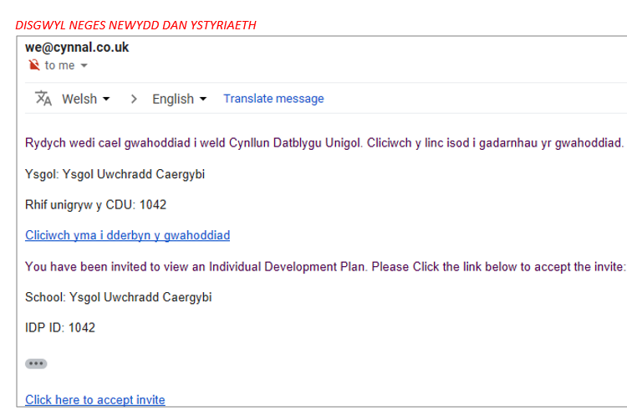
Accepting an invitation to contribute to a 1PP
Ma

Slide 47
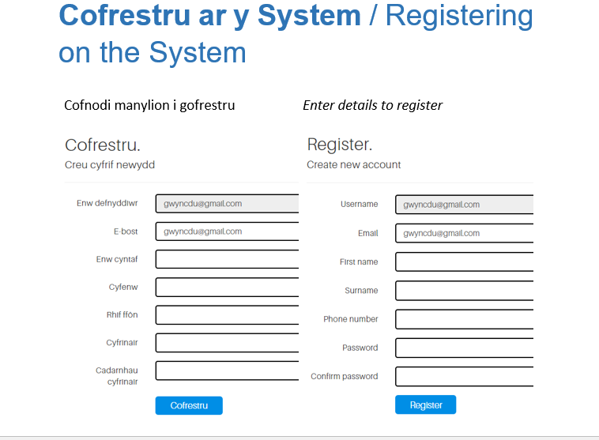
Accepting an invitation to contribute to a 1PP
Ma

Slide 48
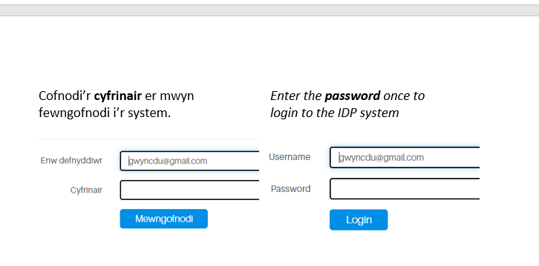
Accepting an invitation to contribute to a 1PP
Ma

Slide 49
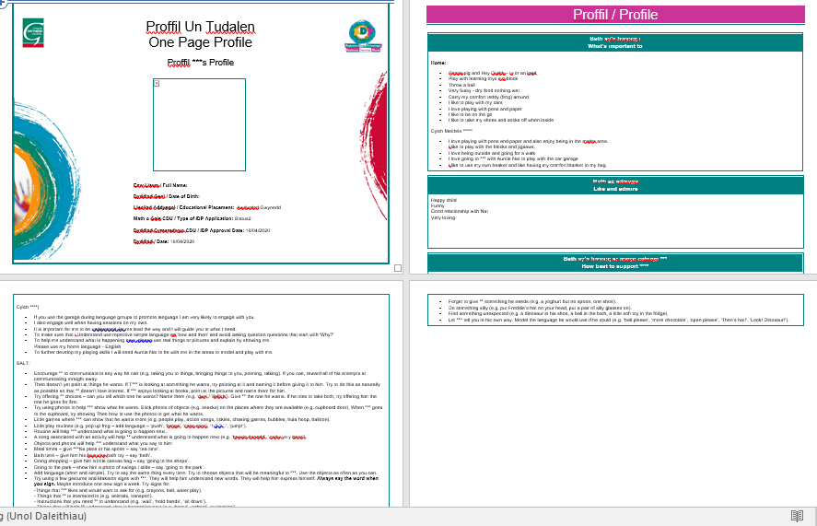

Setting to act on the 'Targeted Universal Provision' tier - use specific assessments / checklists for the areas of concern e.g. ABC Tracking Profile.
Advisory Teacher may consult and / or observe. Record on ready template
Setting to create a one page profile on the Digital System – Setting to set personal targets in the 'What's important for' column. Parent, advisory / specialist teacher with any service relating to the child to be invited to contribute to the profile (recorded on F2)
ABC Tracking profile
Set ‘SMART’ targets drawn from observation, assessments or checklists
One Page Profile

Slide 50
Consultation recording form and / or observation by Advisory Teacher

Slide 51
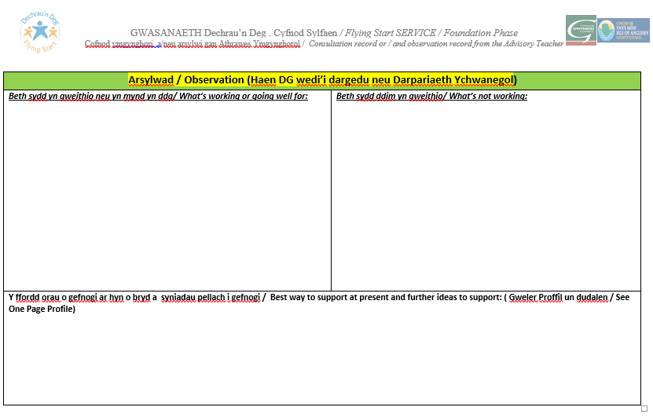
Consultation recording form and / or observation by Advisory Teacher
Ma

Slide 52
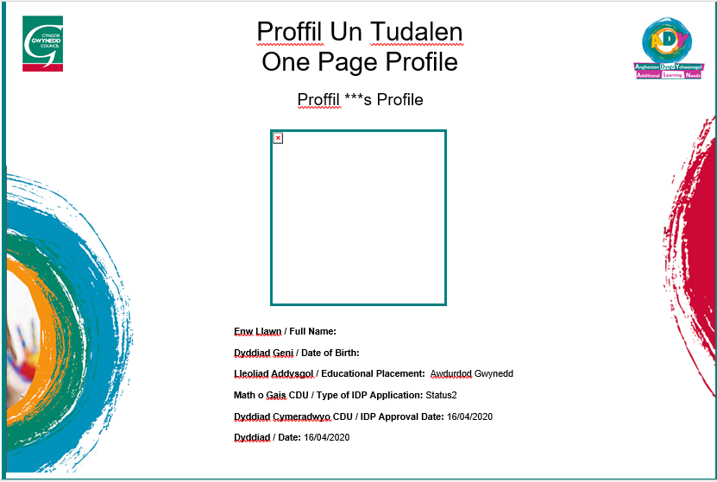

Slide 53
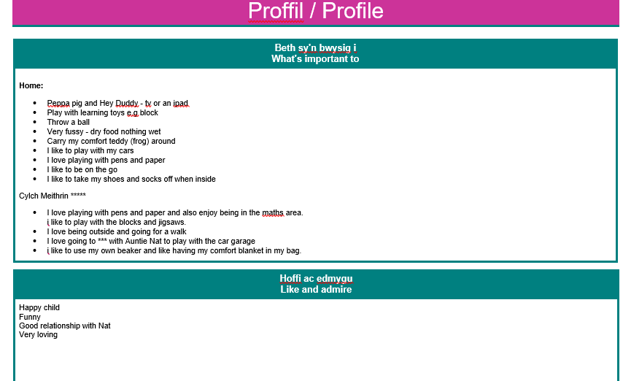
Ma

Slide 54
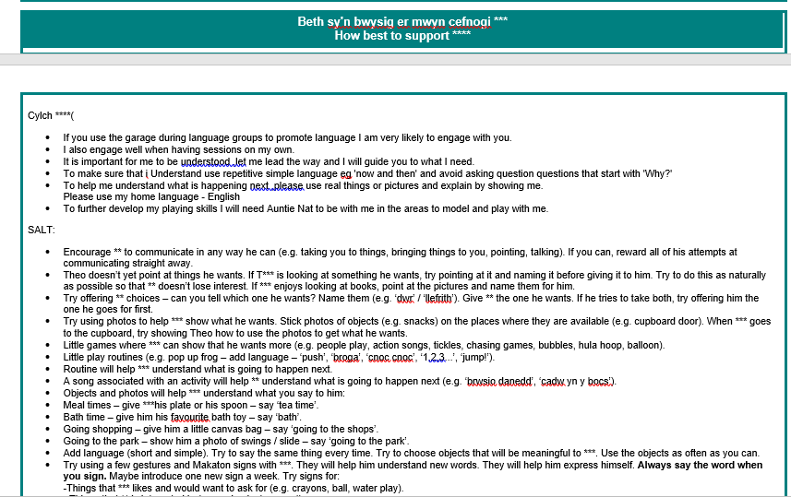
Ma

Slide 55

Review
Setting to review targets and checklists and / or observations. The setting may consult the advisory / specialist teacher (record on advisory teacher form) and / or related services if required.
Meet with Parent / Guardian and any service relating to the child: discuss what is working / not work and report on effectiveness of provision. Refine the profile and agree actions. Record on F1
Lack of Progress and has had intervention
Progress
Lack of Progresst
Refer to Early Years Panel for Additional Provision (Extra pair of Hands)
and / or Refer to the attention of the LEA
----------------------------------
Continue on the Additional Provision tier
Act on the targeted universal provision tier:
Continue on the targeted Universal Provision tier or step down to the Universal Provision tier.
Act on the additional learning provision tier (yellow)
Continue on the additional learning Provision tier or step down to the targeted Universal Provision tier
Refer to relevant Service e.g. Services / Packages within Flying Start, Speech and Language Therapist,, OT, HV - Hearing / sight test

Slide 56
Important points
Review
It is important to invite everyone involved with the child e.g. Flying Start Children: YI and Family Support Worker (Working with 0-5 year olds)
At the end of the Summer Term, it is important to invite the Primary School to which the child will transfer.

Slide 57
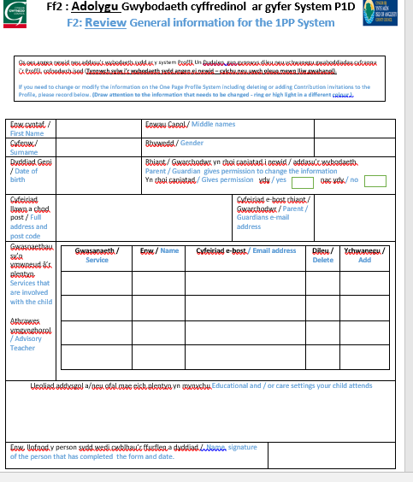
F2: Review information
If the information needs to be changed or invitations needs to be added or removed to or from the profile,
Send a review form (F2) to the Officer of the Authority. Ellen Jones during the interim period

Slide 58

Questions
- chat in Zoom?

Slide 59

1 Page Profile
Person-centred practice
Notes:
59

Slide 60
Important to...
What is important to an individual includes what people only "say":
- with their words
- in the way they behave
When words and behavior contradict each other, take notice of the behavior .
Notes:
The things that are important to us are the things that we say as individuals are important to us. We say these things through our words and actions. When what we say is directly contradicted by our actions then it is usually the actions that are the more honest reflection of what is important to us. These can be about people, things we like to do, possessions, routines and rituals etc
60

Slide 61
Important for
The best way to support...be healthy and safe
What others need to know or do...
It only includes those things that we need to consider in terms of health or safety matters
Notes:
Environment: room arrangements, adaptions. Equipment and resources. Mobility, medication, diagnosis and how best to support your child. What are the routines that support your child at home and out and about (mealtimes, sleeping etc)? Intimate care routines. How do people currently support your child? Are there any dangers we need to consider in relation to your child? Do they put things in their mouth, bite others, run off? What are your child’s communication needs? Does your child have any allergies or medication?
61

Slide 62

Balance
Important to
.
Important
for...
Notes:
62
Just because something is important to you doesn’t mean you are going to get it, and just because it is important for you doesn’t mean we do it to you – we have to work out where the balance is and how we can accommodate it.
62

Slide 63


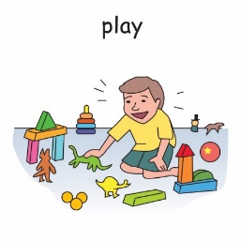
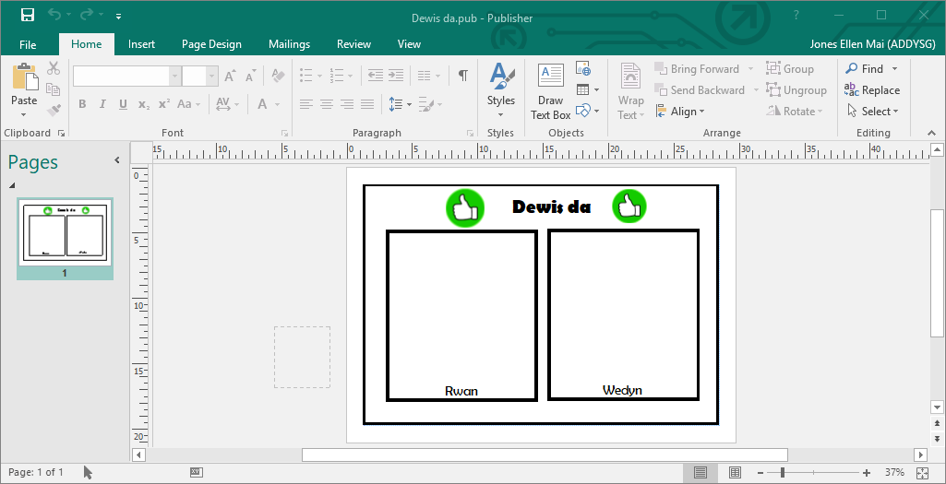
Example
Important to
Important for

Slide 64


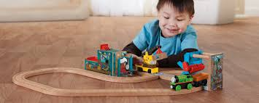





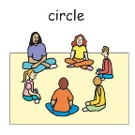


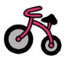

Example
Important to..
Important for...
Rhannu
Visual time table

Slide 65


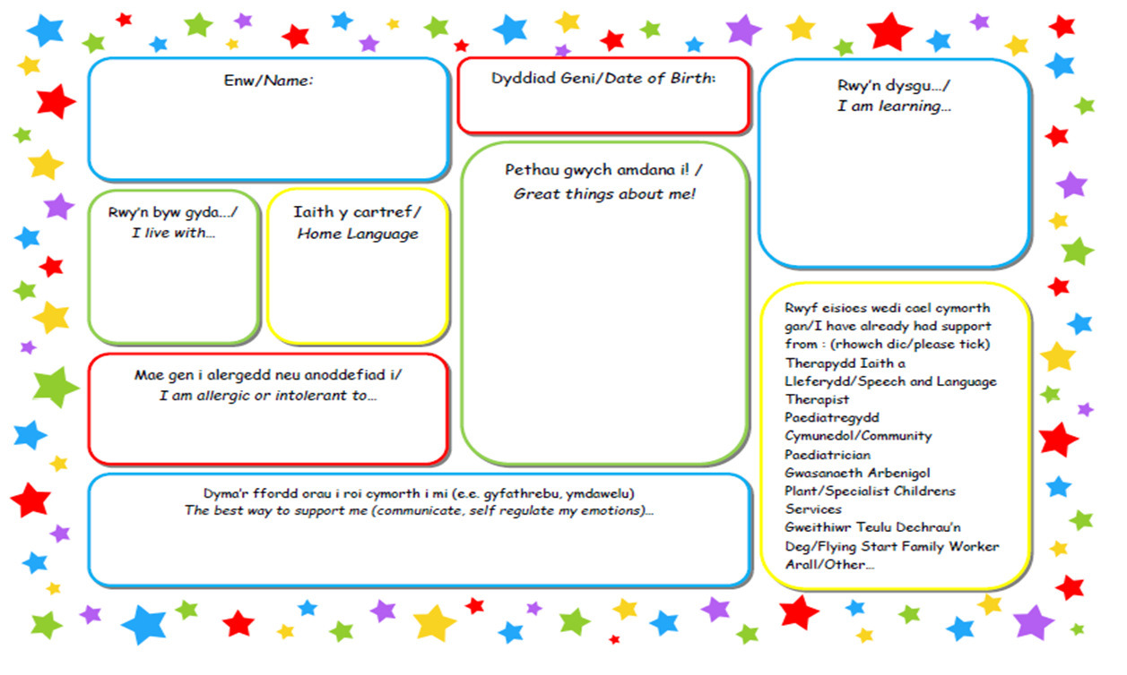
Gather information
Guessing and asking
If the child does not speak, you can ask relatives, friends and staff members who know them well
6 key questions and thinking tools :
1) Who are the most important people to you? (how often do you spend time with them? What do you do together?
2) What do you usually / always do? (in the evenings, during the week. Television programs, hobbies, interests, people you see, places to go, sounds they like, sleeping patter)
3) What would you be unable to leave home without? (a treasured possession)
Gathering information leaflet
Notes:
65

Slide 66
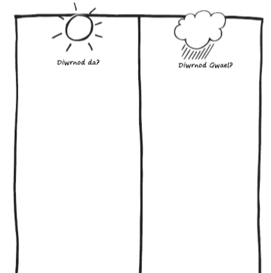
Gathering information
4) What would your best day and your worst day be? (use the mind map - good day and bad day)
Gather information by:
- Observing
- having conversations
What do you do on your favourite day?
When do you have most fun?
What makes you feel good?
Who is with you for all parts of the day?
Where do you do this activity?
Notes:
Canfod gwybodaeth penodol. Deall mwy am yr hyn sy’n bwysig i’r plentyn ac i wneud yn siŵr fod ganddynt yn union y gefnogaeth maent ei hangen bob dydd.
66

Slide 67

5) Learning Log (use the mind map – learning log
Effective method to gather what we’ve learnt rather than what has happened
DYDDIAD Date | BETH WNAETH Y PERSON? What happened | PWY OEDD YNO? Who was there | BETH WNAETHOCH CHI DDYSGU AM YR HYN WEITHIODD YN DDA? What have you learnt that worked well? | BETH WNAETHOCH CHI DDYSGU NAD OEDD YN GWEITHIO? What have you learnt that does not work so well?
27/1/20
29/1/20 | Hit her friend | Sam, Gwen and Twm |  | It was tidying up time –no warning was given
Shared a toy with her friend
Miss Sian, Gwen and Sam
Use visual card and sand timer

Slide 68
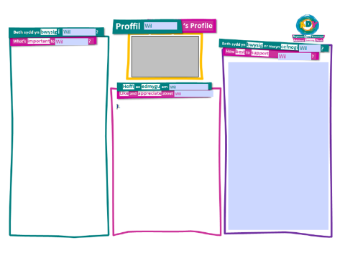
Gathering information
Like and admire
Positive
6) What do your family and friends say that they love and admire about you? (contributes to the like and admire section)
Notes:
68

Slide 69
Like and admire
For every negative element, ask three questions:
Are there circumstances where the negative element is positive?
If so, add to the appreciated things
Does the negative element reflect something that is important to the individual?
If so, add to the important to list
Is the negative element a problem at times? If so, what do other people need to know or do to support the individual when it is a negative element? Add to the Important for list
Notes:
69

Slide 70


How effective is the one page profile?
Quality one page profile
Have included What's important to ...
Have included 'What is important for ... instruction
Balance between 'important to' and 'important for'
Positive Statements
Plenty of details so that anyone can use the information immediately.
Everyday language and no jargon
Correct, clear and easy to read information
Notes:
70

Slide 71
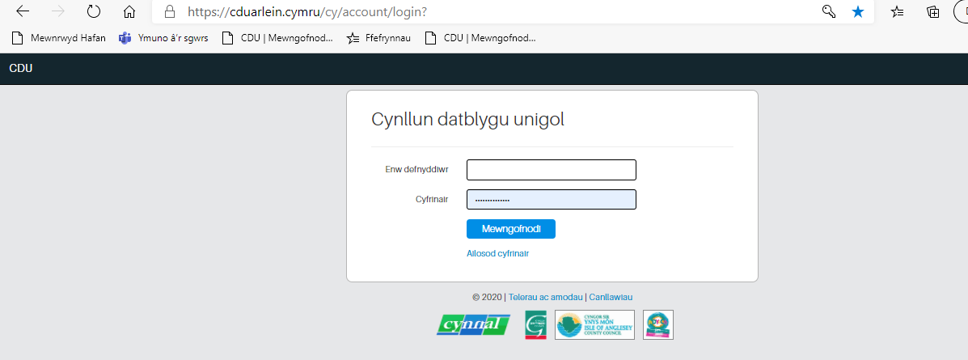
Receiving an invitation to contribute to the 1PP
Website address – save in favourite
https://cduarlein.cymru/cy/account/login?

Slide 72
Visual resources
Using pictures to support language is vitally important in helping children in the early years to -
Understand what is being said and do rather than follow others.
Accept what is being said
Cope in a situation
Not having to guess what is being said
Enjoy what's happening
Reduce anxiety level

Slide 73
Visual time table in every early years setting – Universal provision
A visual way of presenting the routine. Every setting should have a visual schedule.
Why?
Everyone thrives with routine
Structure allows them to organize their thinking and anticipate events
Set expectations in a simple way
Reduce anxiety level
Anxiety can make audio information difficult to process
Additional Learning Provision
Universal Provision
Targeted Universal Provision

Slide 74
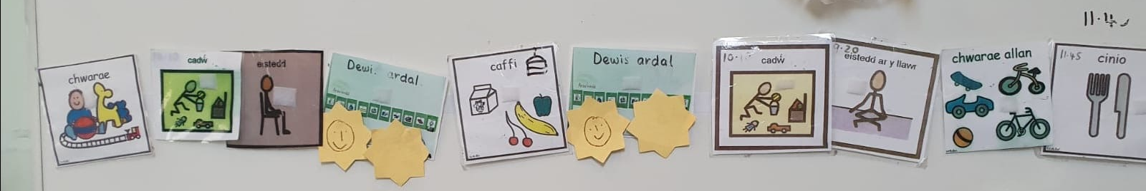
Visual time table in every early years setting – Universal provision
How?
Laminated picture cards
Locate in a visible position
Ideally set them across (simulate the reading process)
Practitioners to use with everyone to move from one activity to another by drawing the children's attention to the picture and giving a warning e.g. 'In 2 minutes playtime finishes, THEN tidying up' (keep language very simple) A sand timer can be used. Some will need reminding using a picture on the keyring. After two minutes' Now, tidy up (point to the picture) then playtime’ and turn the card around.
An integral part of your daily practice

Slide 75
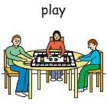
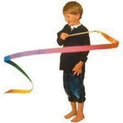
Now and Then cards- Targeted Universal provision
Why?
Some have difficulty moving their brains between different tasks
Help prepare the brain for the change ahead
Support the transition from one activity to the next
An effective way to reduce the time they spend in one activity
Effective approach with a child who continually insists on 'what's important to ..'
To show 'then' a reward to motivate the child to engage in an activity
Additional Learning Provision
Universal Provision
Targeted Universal Provision

Slide 76
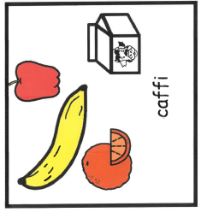

Now and Then cards- Targeted Universal provision
How?
Laminated mini cards
Template now and Then A4
Show both pictures and point to the pictures saying
'Now' cafe 1 'Then' bubbles 2 'If a child goes away reinforce showing the cards again.
After completing activity 1, point to the picture and say ‘cafe 1' finish, now ‘bubbles 2' It is important to start activity 2 straight away so that the child can understand the process.
Card now and then work effectively if ‘then' activity is important to….
Make consistent use of the resource

Slide 77
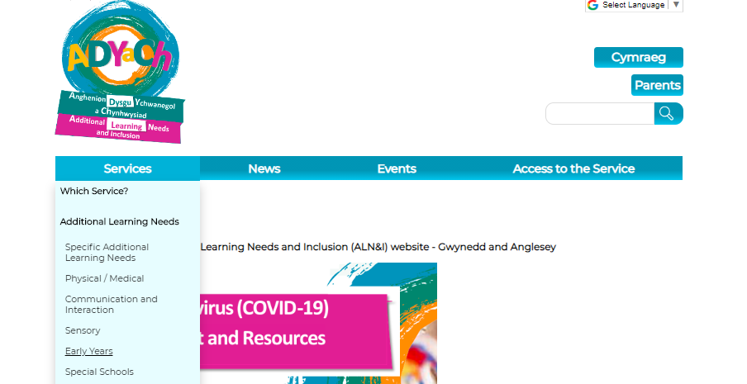
ADYaCh Gwynedd a Môn Website https://adyach.cymru
1: Click on the ‘service’ tile
2: Click on the ‘Early Years’ tile

Slide 78
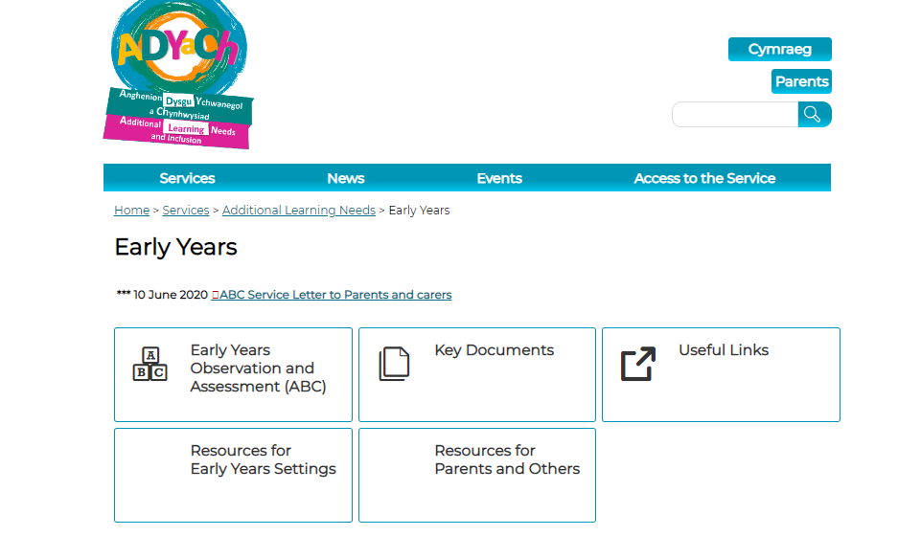
ADYaCh Gwynedd a Môn Website
Provision Map, Supplementary document, F1, F2, and the new referral form
Visaul resources – Time table and Now / then template

Slide 79
What Next?
Familiarise yourself with the Provision Map document and appendices
Consider when the process can begin to be implemented
Question and Answer Session 12/1/21 (zoom meeting details to follow)
Arrange supervision sessions (with LA officers and settings) - By the end of January
Further training program developed based on your response
Training to introduce guidance for the Additional Provision (yellow) tier and Person centered approach to facilitate positive communication (Spring Term)
Code in effect from September 2021

Slide 80
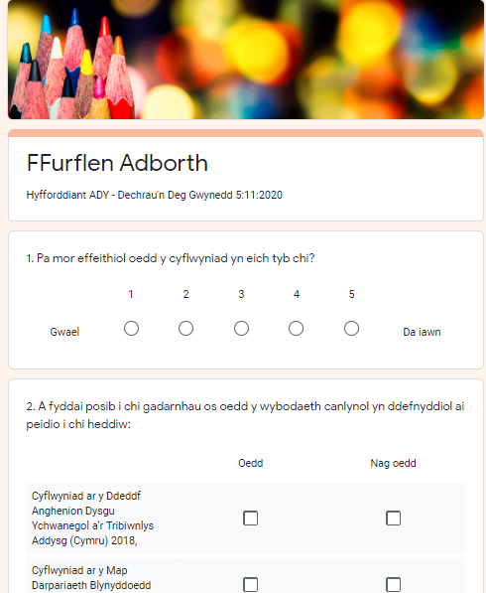

Feed Back Form
https://forms.gle/WwJYiZLKRCJEMRiG7
Thank You

