Slide 1






ALN Training
Ellen Jones ellenjones@gwynedd.llyw.cymru
Put your computer on mute please.

Slide 2
AGENDA
Presenting important messages from the ALN Code
Introduce the 'Provision Map' document and processes for using it
One page profile and the IDP Digital System
Effective visual resources at the level of Universal Provision and Targeted Universal Provision

Slide 3
ALN Draft Code December 2018
What will change?
How will the Act affect the way you work?
Notes:
Disodli’r system presennol sydd dros 30 mlynedd ac yn anaddas i’r diben rŵan
Cyfnod ymgynghori wedi dod i ben diwedd Mawrth – casglu ac ymateb i’r ymatebion.
Cod drafft terfynol yn cael ei chyhoeddi Rhagfyr 2019 – os na fydd rhywbeth cyfreithiol mawr wedi codi o’r ymgynghoriad
Dim ‘cod ymarfer’ fel yr un presennol
Does dim angen gôr boeni am y newidiadau – ALl yn cyd weithio ac yn arwain drwy’r newidiadau
3

Slide 4

Terminology
Introducing the term
'Additional Learning Needs'
ALN
Notes:
O dan y Ddeddf, disodlir y term AAA ac anawsterau dysgu neu anableddau, a defnyddir y term newydd, ADY.
Term AAA – yn cynnwys SIY, MAT, Meddygol
4

Slide 5
The Definition of ALN
A person has additional learning needs if he or she has a learning difficulty or disability (whether the learning difficulty or disability arises from a medical condition or otherwise) which calls for additional learning provision.
(2) A child of compulsory school age or person over that age has a learning difficulty or disability if he or she—
(a) has a significantly greater difficulty in learning than the majority of others of the same age, or
(b) has a disability for the purposes of the Equality Act 2010 (c. 15) which prevents or hinders him or her from making use of facilities for education or training of a kind generally provided for others of the same age in mainstream maintained schools or mainstream institutions in the further education sector.
(3) A child under compulsory school age has a learning difficulty or disability if he or she is, or would be if no additional learning provision were made, likely to be within subsection (2) when of compulsory school age.
Notes:
O dan y Ddeddf, disodlir y term AAA ac anawsterau dysgu neu anableddau, a defnyddir y term newydd, ADY.
Term AAA – yn cynnwys SIY, MAT, Meddygol
5

Slide 6
What is / not ALN
Some children may have a disability or medical condition that does not require ALP. The following examples provide clarity on what ALN is and what it is not.
If a child under compulsory school age had a significant speech, language and communication delay, and it was considered (by the local authority or maintained nursery in which they are registered) that ALP was required, and it was decided that the child has ALN, an IDP would be put in place.
Some disabilities may affect a child’s access to a setting that provides childcare or nursery education, but their disability would not affect their learning, e.g. if they required use of a wheelchair or required PEG feeding. Once the necessary arrangements were put in place to allow the child to access the setting they would not necessarily need ALP and would not, therefore, have ALN
Notes:
O dan y Ddeddf, disodlir y term AAA ac anawsterau dysgu neu anableddau, a defnyddir y term newydd, ADY.
Term AAA – yn cynnwys SIY, MAT, Meddygol

Slide 7
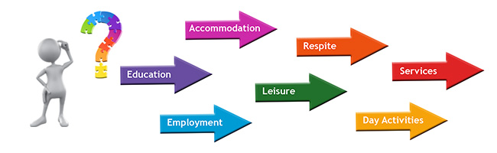
0-25 age range
A single legislative system to support children and young people with ALN who are 0 to 25 years old.
This replaces the current separate systems that supports the early years, schools and post-mandatory education.
Notes:
7

Slide 8


One Plan
The following is superseded:
Action in the early years (play plan)
Action in the early years and more by means of individual development plans 'in the school' (play plan)
Statement
The Act creates a single statutory plan - an Individual development plan (IDP) and replaces the range of statutory and non-statutory plans that currently exist for children
Notes:
Mae’n annog asiantaethau i gydweithredu a rhannu gwybodaeth, sy’n hanfodol er mwyn sicrhau y nodir anghenion yn gynnar.
Bydd rolau statudol megis y Swyddog Arweiniol Clinigol Dynodedig Addysg (DECLO) a’r swyddog arweinyddol blynyddoedd cynnar yn anelu at esmwytho cydweithrediad a threfniadau pontio.
Dweud fy stori un waith
8

Slide 9
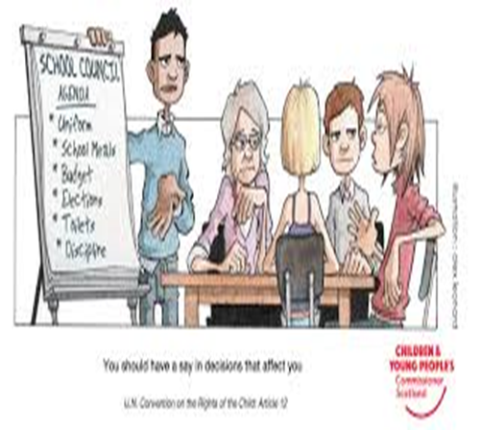
Who will contribute to the IDP?
The child
Parents / Guardians
Key workers within an Early Years placement
External services (Health / care)
Notes:
Reviews will focus on the individual, and pupils and their families will be supported to contribute to plans, outcomes and future provision in order to satisfy need.
9

Slide 10
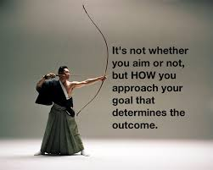

Outcomes
The IDP will focus on the provision that ensures real outcomes
The method of target setting will change. Our focus will be on person-centred outcomes.
Notes:
Deilliannau sydd yn sicrhau bod plentyn yn cyflawni ei botensial yn llawn.
10

Slide 11

Reducing conflict
Where there is disagreement about an Individual Development Plan or the provisions within it, the emphasis will be on considering the matter and resolving it on the most local level possible.
Notes:
11

Slide 12

Right to Appeal
Unless disagreement about the content of the IDP or the additional learning provision on a local level can be resolved, the Act ensures that children and young people (and their carers / parents in the case of those under 16 years old) have the right to appeal to a tribunal.
Notes:
ALl fydd yn gyfrifol – deddf ADY
Lleoliadau yn gyfrifol – deddf cydraddoldeb 2010
12

Slide 13

A bilingual system
Every service must consider whether a pupil requires a Welsh-medium additional learning needs provision.
Every reasonable step must be taken to ensure that the needs of the pupil are met through the medium of Welsh if he/she so wishes.
Notes:
13

Slide 14
Important messages from the ALN Draft Code, December 2019
It does not state that the role of the ALNCo is required in Early Years settings. However, 'National Minimum Standards for regulated childcare – standard 4' (Meeting Individual Needs) states the need to have a designated person within the setting.
It is not necessary to get a parent's consent to refer a child to the Authority's attention.
Statutory role of the ALN Leader - Source of Information for education – Ellen Jones
Statutory role of the DECLO – Source of information for health: Wen Hayton
Notes:
Replacing the current system that is over 30 years old and is now not fit for purpose
Consultation period expired at the end of March - collect and respond to the responses.
The final draft code will be published in December 2019 - if no major legal issue is raised in the consultation
Not a 'code of practice' as the current one.
No need to worry too much about the amendments - LA will work with us and guide us through the changes
14

Slide 15
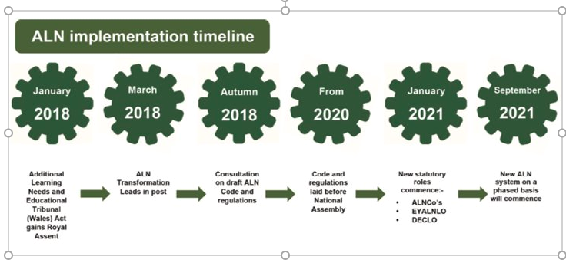
Notes:
Replacing the current system that is over 30 years old and is now not fit for purpose
Consultation period expired at the end of March - collect and respond to the responses.
The final draft code will be published in December 2019 - if no major legal issue is raised in the consultation
Not a 'code of practice' as the current one.
No need to worry too much about the amendments - LA will work with us and guide us through the changes
15

Slide 16

Any Questions?
Use the chat option please.
Notes:
16

Slide 17
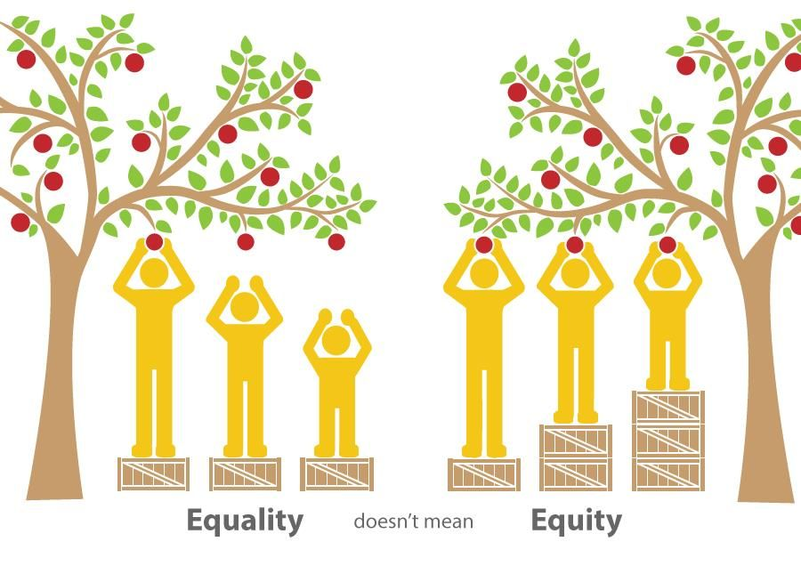
What is inclusion?
One of the principles of the ALN Code is inclusive education where, wherever practicable, children are supported to take full advantage of mainstream education and the whole setting seeks to meet the needs of a child with ALN. The ALN Code provides guidance on the process of assessing and deciding whether a child has ALN.
Notes:
Adnabod cryfderau a meysydd sydd angen cefnogaeth. Goresgyn unrhyw rhwystr drwy; addasiadau, darparu adnoddau pwrpasol a / neu darparu cefnogaeth amserol
Bod yn wyliadwrus nac ydym yn gôr label plant – gallu cael effaith negyddol ar ddeilliannau

Slide 18

Early Years Provision Map
Ma

Slide 19
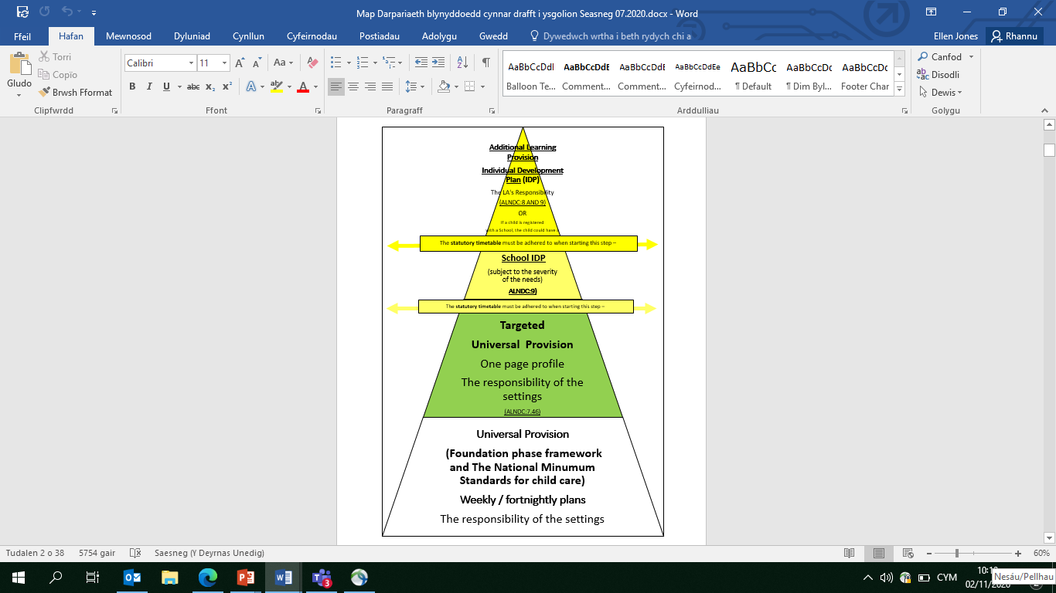
Provision Map Model
Notes:
Adnabod cryfderau a meysydd sydd angen cefnogaeth. Goresgyn unrhyw rhwystr drwy; addasiadau, darparu adnoddau pwrpasol a / neu darparu cefnogaeth amserol
Bod yn wyliadwrus nac ydym yn gôr label plant – gallu cael effaith negyddol ar ddeilliannau
19

Slide 20
Universal Provision
Universal provision supports the entire population, i.e. the whole room / class or entire setting and ensures that every child has the appropriate opportunities to make progress
This level includes workforce development, access to appropriate information, creating environments that are communication-friendly, and class/room/whole setting intervention methods.
Notes:
Datblygu’r gweithlu – mynediad at wybodaeth briodol, creu amgylcheddau cyfeillgar i gyfathrebu a dulliau ymyrraeth dosbarth / ystafell gyfan
E.E: amserlen weledol, makaton, ystafell wedi’i drefnu’n ofalus,
DDASIADAU RHESYMOL
20

Slide 21
What are reasonable adjustments?
The Equality Act 2010 provides a single, consolidated source of discrimination law. It simplifies the law and it extends protection from discrimination in some areas.
As far as schools are concerned, meaning that schools cannot unlawfully discriminate against pupils because of their sex, race, disability, religion or belief or sexual orientation.
Notes:
Tynnu sylw yn ôl at beth yw a beth sydd ddim yn ADY.
21

Slide 22
Targeted Universal provision
Based on sources of evidence of a child's attainment and/or progress, settings must provide specific interventions and/or strategies in order to respond to the specific fields that cause concern.
Notes:
Dull ymateb graddoledig. Cam i dargedu plant ond ddim o rheidrwydd yn blant ADY.
22

Slide 23
Additional Learning Provision
Additional provision is defined in the Draft ALN Code (2018) as:
(1) “Additional learning provision” for a person aged three or over means
educational or training provision that is additional to, or different from, that made
generally for others of the same age in—
(a) mainstream maintained schools in Wales,
(b) mainstream institutions in the further education sector in Wales, or
(c) places in Wales at which nursery education is provided.
(2) “Additional learning provision "For a child aged under three means educational provision of any kind.
(3) In subsection (1), “nursery education” means education suitable for a child who has reached the age of three but is below compulsory school age.
Notes:
Iechyd a/ neu’r ALl fydd yn gyfrifol am DdY
23

Slide 24

Provision Map
Whose responsibility?
Following the wheel
1:Observing and Assessing
3:Providing
2:Planning
4:Reviewing
Authority
IDP
Schools
IDP
Early Years Settings
One page profile
Early Years Settings
Plans
IDP: Individual Development Plan
24

Slide 25
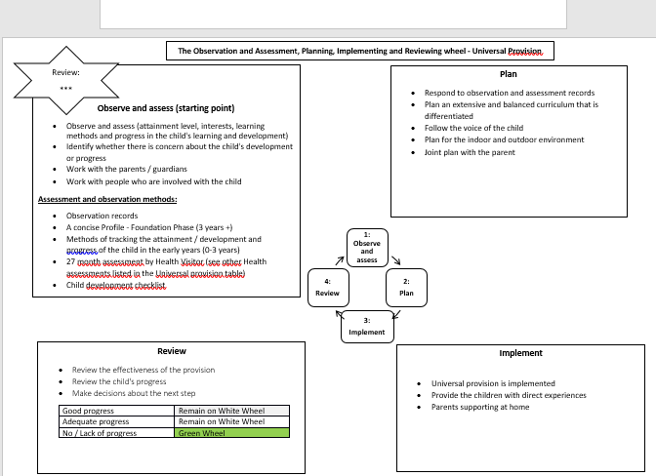


Universal Provision Wheel

Slide 26
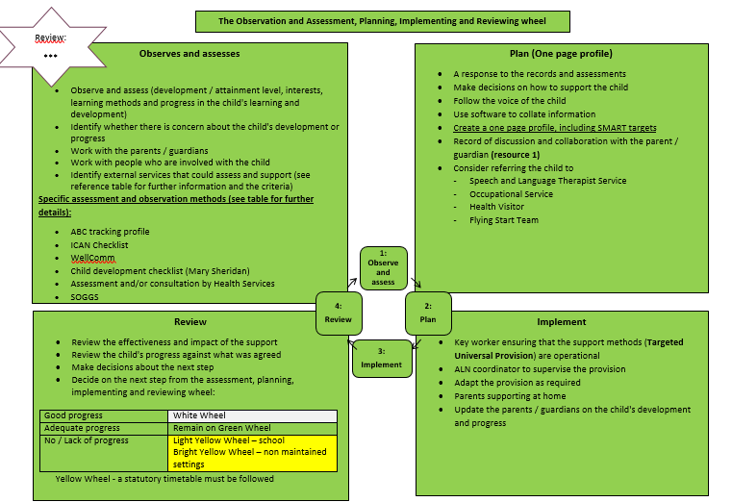
Targeted Universal Provision Wheel

Slide 27
Access to additional provision in the Early Years flow chart
Week 1-6
Share the decision with the parent and the services involved with the case
Step 1:
Draw the attention of the LA to the possibility that a child may have ALN
Step 2:
Gather evidence
(ALN criteria form)
Step 3a:
Small Moderation Panel to validate the decision (DALNC:8.9 - ask a psychologist)
No ALN
ALN
Week 7-12
Step 3b
Decide which service is likely to provide additional support / provision
Step 4: Draw up an AIDP
Step 5: Present the IDP to the attention of the Moderation Panel to validate the ALP
Step 6: Present the IDP to the parent / guardian and the services involved with the case

Slide 28
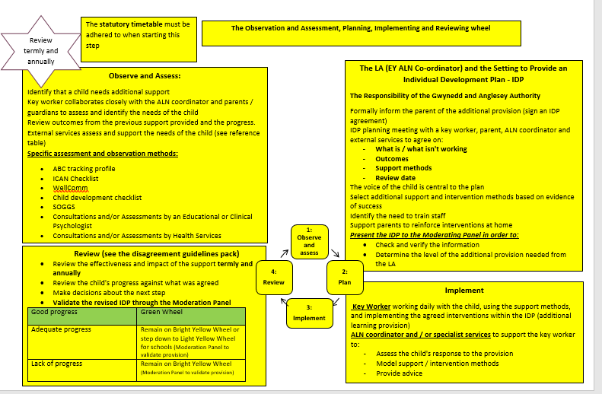
Additional Provision Wheel (Local Authority

Slide 29
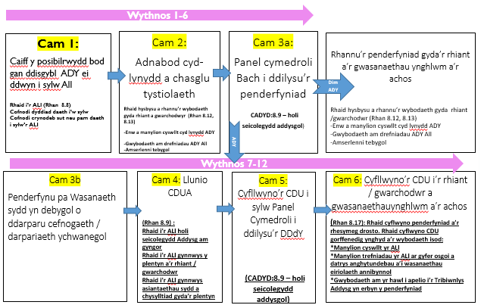
Entry points when starting in a setting
A child may enter a setting at any tier within the provision map depending on the level of provision the child has received at home or at a previous setting.
C Entry Point
B Entry Point
A Entry Point

Slide 30
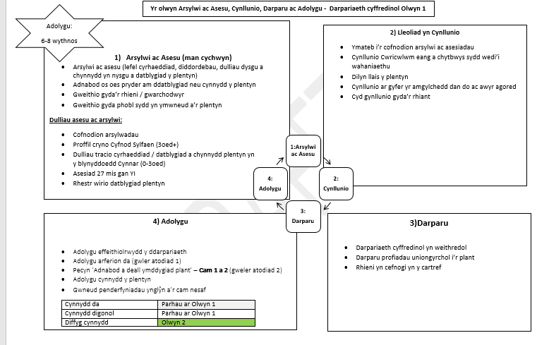
A Entry Level or starting Point
Ma
Access to the setting – Setting to talk with parent
Setting to operate on the Universal Provision layer (white wheel).
Teacher may consult at Universal provision level (situations / routines of concern) Record on Advisory Teacher record form
1:Observe and assess
3:Provide
4:Review
2:Plan

Slide 31

A Entry Level or starting Point
Observation and assessment methods have highlighted a concern (achievement or progress)
Setting to arrange an initial meeting with the parent / guardian. Share information and agree on actions
Record on F1
Complete F2
Complete or revise the Information sheet ready to create a one page profile
Share the pamphlet 'What is a one-page profile' with the parent / guardian and explain the process of how to receive an invitation to contribute to the one-page digital profile via e-mail. Explain that a 6 digit code will need to be received from the setting to register on the system. Share/discuss the guidance booklet.

Slide 32
Important information
F1:to remain in the setting adhering to the setting's data protection policy (Menna will be aware that you have a child stepping onto the green level (targeted Universal Provision) as she receives an invitation to contribute to the One-page Profile).
F2: Email for the attention of the Authority Officer (Ellen Jones during interim) ellenjones@gwynedd.llyw.cymru. The form must be password protected Ff2Mon

Slide 33
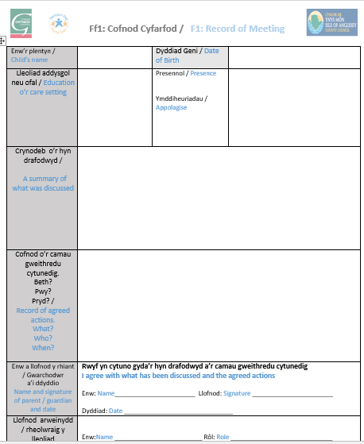
F1 – Meeting Record
Ma

Slide 34
What needs to be recorded on the F1 form?
Ma
Possible examples
Initial meeting: Why do we need a discussion? - (parent, agencies or setting may express concern)
Review meeting: to discuss progress against set targets. Share what works / doesn't work. Updates from other agencies
Initial meeting: referral to a specific service eg Language Therapy Service, Occupational Therapy. Liaise with specialist teacher to observe and / or consult. Identify the type of strategies and resources that will be used eg additional WellComm targeting session, now and then card (see provision map document) Next meeting arrangements.
Review meeting: Responding to what doesn't work. Identify if there is a need to adapt the type of strategies and resources used. Referral to agency. Liaise with specialist teacher to observe and / or consult. Next meeting arrangements.

Slide 35
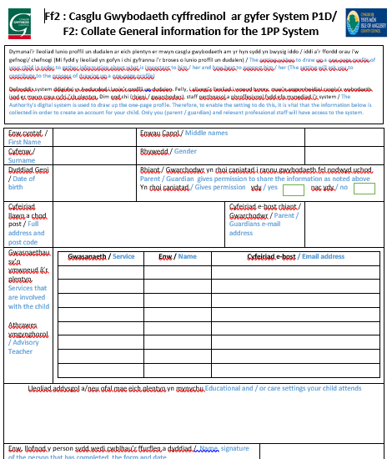
F2 – Collect Core Information

Slide 36
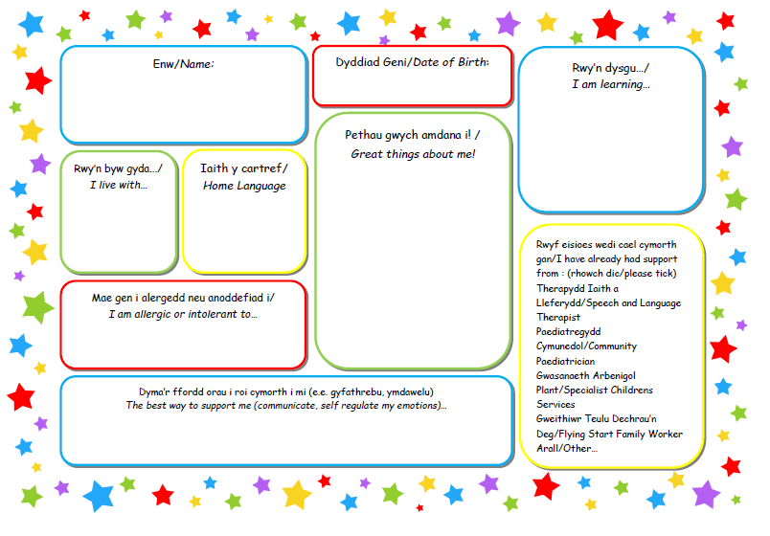
Complete or review information collection sheet

Slide 37
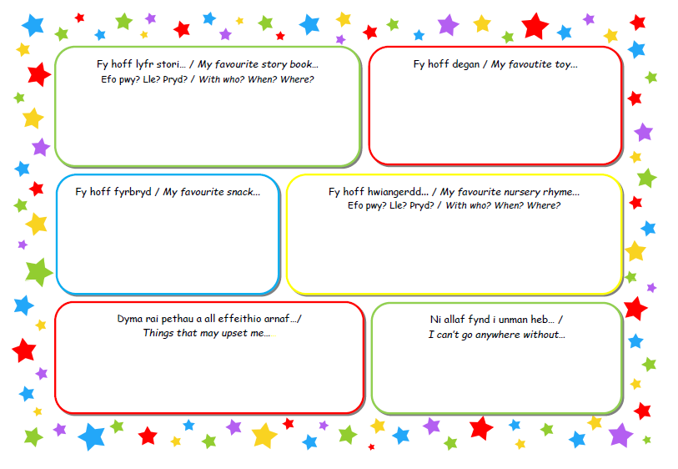

Slide 38
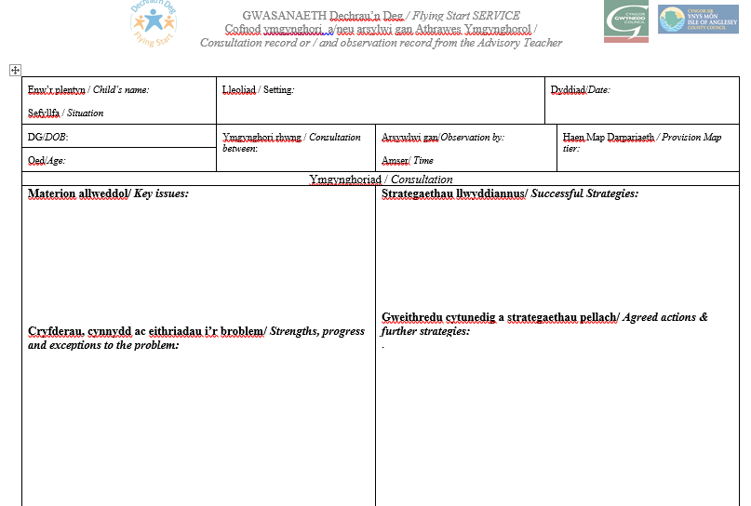
Consultation recording form and / or observation by Advisory / Specialist Teacher
Ma
Universal provision

Slide 39
B Entry level
Setting to arrange a meeting with the parent / guardian, leader /manager and any service involved with the child / family including previous setting before the child commenced at the setting or transferred from another setting.
Record on F1
Complete F2
Complete or revise the Information sheet ready to create a one page profile
Share the pamphlet 'What is a one-page profile' with the parent / guardian and explain the process of how to receive an invitation to contribute to the one-page digital profile via e-mail. Explain that a 6 digit code will need to be received from the setting to register on the system. Share/discuss the guidance booklet.
Important
Flying Start settings to contact Cylchoedd Meithrin half term before transfer

Slide 40
Important information
F1:to remain in the setting adhering to the setting's data protection policy (Menna will be aware that you have a child stepping onto the green level (targeted Universal Provision) as she receives an invitation to contribute to the One-page Profile).
F2: Email for the attention of the Authority Officer (Ellen Jones during interim) ellenjones@gwynedd.llyw.cymru. The form must be password protected Ff2Mon

Slide 41
C Entry Level
Referral Scheme
Children with profound and complex needs
Setting to arrange a meeting with the parent / guardian, leader /manager, specialist teacher and any service involved with the child / family including previous setting before the child commenced at the setting or transferred from another setting.
• Share key information and agree on the actions Record on Form1
Complete F2 and the Information Gathering Leaflet
Share the pamphlet 'What is a one-page profile' with the parent / guardian and explain the process of how to receive an invitation to contribute to the one-page digital profile via e-mail. Explain that a 6 digit code will need to be received from the setting to register on the system. Share/discuss the guidance booklet
Important
Flying Start settings to contact Cylchoedd Meithrin half term before transfer

Slide 42
Important information
F1:to remain in the setting adhering to the setting's data protection policy (Menna will be aware that you have a child stepping onto the green level (targeted Universal Provision) as she receives an invitation to contribute to the One-page Profile).
F2: Email for the attention of the Authority Officer (Ellen Jones during interim) ellenjones@gwynedd.llyw.cymru. The form must be password protected Ff2Mon

Slide 43
Pwyntiau Pwysig i gofio
When conducting an initial conversation with the parent (face-to-face or over the phone) it is important to ask sensitively whether the child is open to any other service or receives any additional support / provision. This will allow you to try to identify the child's starting point on the Provision Map Model as shown in the table below.
Not open to another service | Access point A Act on the Universal Provision tier | Talk with the parent
Open to another service e.g. Speech and Language | Access point B Act on the Targeted Universal Provision tier | Setting to arrange a meeting before the child commences
Complex needs and open to services | Access point c Act on the Additional Provision tier | Setting to arrange a meeting before the child commences

Slide 44
Processing the F2 Form
Ma
Setting to email the F2 to LA officer (Ellen – during interim) ellenjones@gwynedd.llyw.cymru
Officer to proces sthe data on the digital system
Officer to share invitations with people involved with the child including parents / guardians
People to accept their email (see guidelines) and contact LA officer (Ellen Jones) to receive a 6 digit code
https://www.cduarlein.cymru/Documents/System_CDU_IDP_Rhieni-Cyfranwyr%20_Parents_Contributors_24102019.pdf

Slide 45
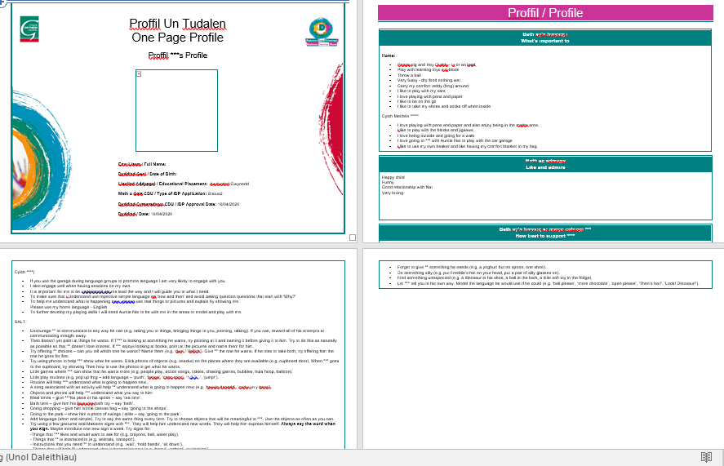

Setting to act on the 'Targeted Universal Provision' tier - use specific assessments / checklists for the areas of concern e.g. ABC Tracking Profile.
Advisory / Specialist Teacher may consult and / or observe. Record on ready template
Setting to create a one page profile on the Digital System – Setting to set personal targets in the 'What's important for' column. Parent, advisory / specialist teacher with any service relating to the child to be invited to contribute to the profile (recorded on F2)
Important points
If the specialist teacher needs to observe or consult you will need to contact them directly to make arrangements: mennajones@ynysmon.gov.uk
ABC Tracking profile
Set ‘SMART’ targets drawn from observation, assessments or checklists
One Page Profile

Slide 46
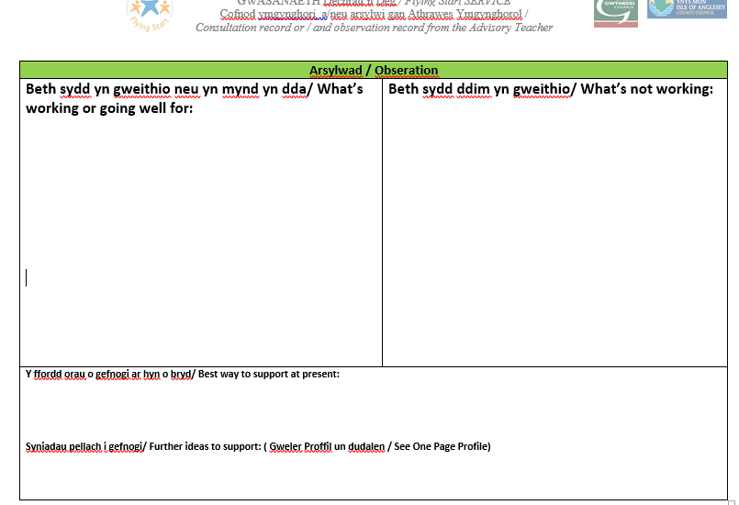
Consultation recording form and / or observation by Advisory / Specialist Teacher
Ma

Slide 47
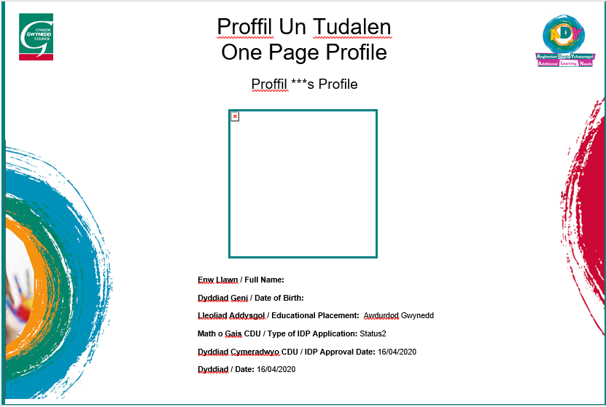

Slide 48
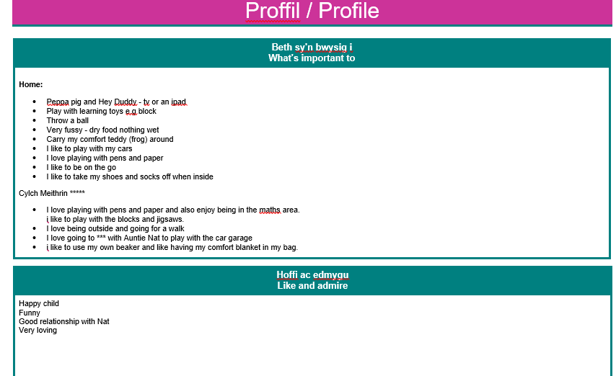
Ma

Slide 49
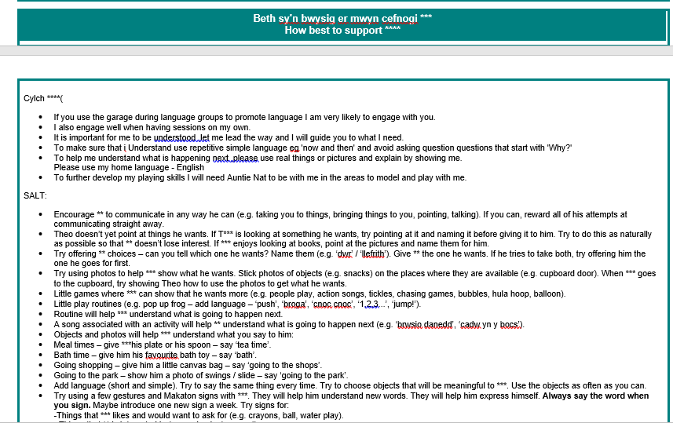
Ma

Slide 50

Review
Setting to review targets and checklists and / or observations. The setting may consult the advisory / specialist teacher (record on advisory teacher form) and / or related services if required.
Meet with Parent / Guardian and any service relating to the child: discuss what is working / not work and report on effectiveness of provision. Refine the profile and agree actions. Record on F1
Lack of Progress and has had intervention
Progress
Lack of Progresst
Act on the targeted universal provision tier:
Continue on the targeted Universal Provision tier or step down to the Universal Provision tier.
Act on the additional learning provision tier (yellow)
Continue on the additional learning Provision tier or step down to the targeted Universal Provision tier
Refer to Flying Start Panel, Referral Scheme or Childcare Offer for Additional Provision - Extra Hands
and / or Refer to the attention of the LEA
Continue on the Additional Provision tier
Refer to relevant Service e.g. Services / Packages within Flying Start, Speech and Language Therapist,, OT, HV - Hearing / sight test

Slide 51
Important points
Review
It is important to invite everyone involved with the child e.g. Flying Start Children: YI and Family Support Worker (Working with 0-5 year olds)
At the end of the Summer Term, it is important to invite the Primary School to which the child will transfer.

Slide 52
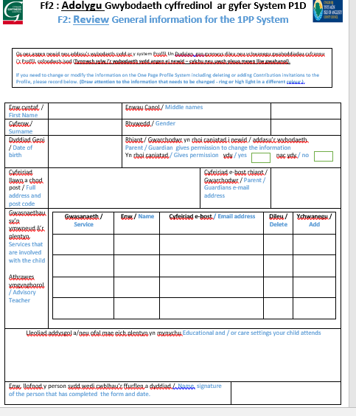
F2: Review information
If the information needs to be changed or invitations needs to be added or removed to or from the profile,
Send a review form (F2) to the Officer of the Authority. Ellen Jones during the interim period

Slide 53

Supplementary Document for settings
Ma

Slide 54

Questions
- chat in Zoom?

Slide 55

1 Page Profile
Person-centred practice
Notes:
55

Slide 57
Ma

Slide 58
Ma

Slide 59
Important to...
What is important to an individual includes what people only "say":
- with their words
- in the way they behave
When words and behavior contradict each other, take notice of the behavior .
Notes:
The things that are important to us are the things that we say as individuals are important to us. We say these things through our words and actions. When what we say is directly contradicted by our actions then it is usually the actions that are the more honest reflection of what is important to us. These can be about people, things we like to do, possessions, routines and rituals etc
59

Slide 60
Important for
The best way to support...be healthy and safe
What others need to know or do...
It only includes those things that we need to consider in terms of health or safety matters
Notes:
Environment: room arrangements, adaptions. Equipment and resources. Mobility, medication, diagnosis and how best to support your child. What are the routines that support your child at home and out and about (mealtimes, sleeping etc)? Intimate care routines. How do people currently support your child? Are there any dangers we need to consider in relation to your child? Do they put things in their mouth, bite others, run off? What are your child’s communication needs? Does your child have any allergies or medication?
60

Slide 61

balance
Important to
.
Important
for...
Notes:
61
Just because something is important to you doesn’t mean you are going to get it, and just because it is important for you doesn’t mean we do it to you – we have to work out where the balance is and how we can accommodate it.
61

Slide 62
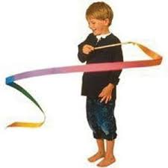
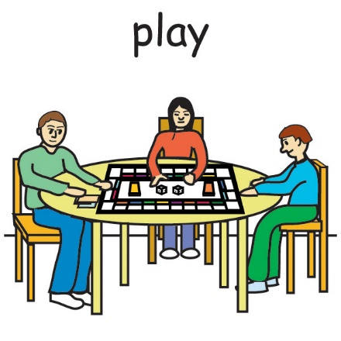

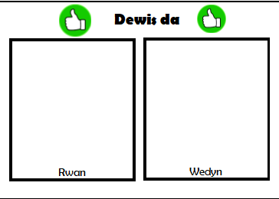

Enghraifft / Example
Yn bwysig i
Important to
Ar gyfer
Important for

Slide 63
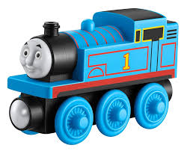

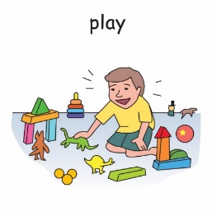
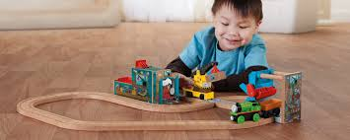





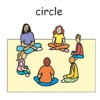


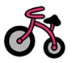

Enghraifft
Yn bwysig i
Ar gyfer
Rhannu
Amserlen weledol

Slide 64


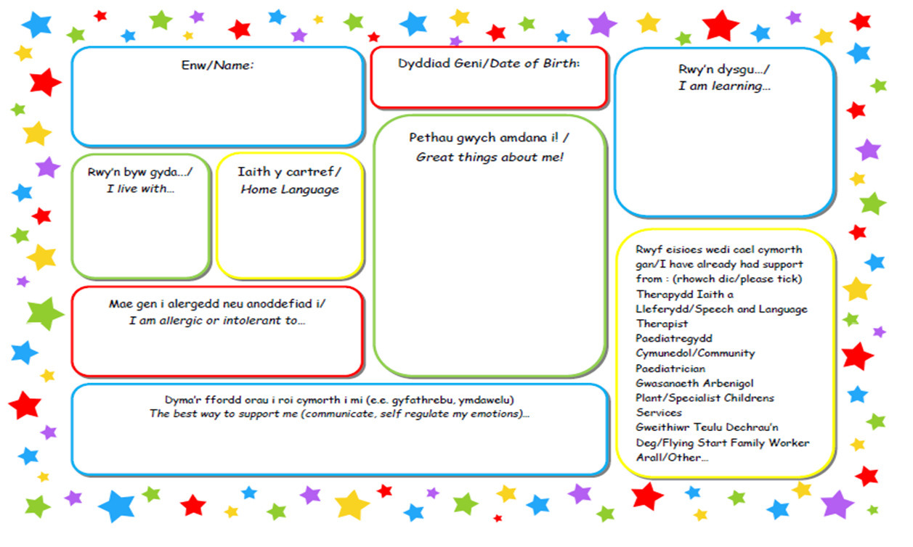
Gather information
Guessing and asking
If the child does not speak, you can ask relatives, friends and staff members who know them well
6 key questions and thinking tools :
1) Who are the most important people to you? (how often do you spend time with them? What do you do together?
2) What do you usually / always do? (in the evenings, during the week. Television programs, hobbies, interests, people you see, places to go, sounds they like, sleeping patter)
3) What would you be unable to leave home without? (a treasured possession)
Gathering information leaflet
Notes:
64

Slide 65
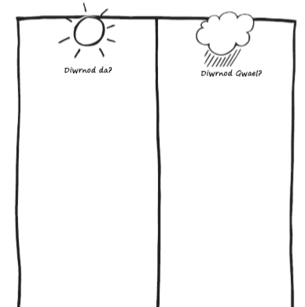
Gathering information
4) What would your best day and your worst day be? (use the mind map - good day and bad day)
Gather information by:
- Observing
- having conversations
What do you do on your favourite day?
When do you have most fun?
What makes you feel good?
Who is with you for all parts of the day?
Where do you do this activity?
Notes:
Canfod gwybodaeth penodol. Deall mwy am yr hyn sy’n bwysig i’r plentyn ac i wneud yn siŵr fod ganddynt yn union y gefnogaeth maent ei hangen bob dydd.
65

Slide 66

5) Learning Log (use the mind map – learning log
Effective method to gather what we’ve learnt rather than what has happened
DYDDIAD Date | BETH WNAETH Y PERSON? What happened | PWY OEDD YNO? Who was there | BETH WNAETHOCH CHI DDYSGU AM YR HYN WEITHIODD YN DDA? What have you learnt that worked well? | BETH WNAETHOCH CHI DDYSGU NAD OEDD YN GWEITHIO? What have you learnt that does not work so well?
Shared a toy with her friend
Miss Sian, Gwen and Sam
Use visual card and sand timer

Slide 67
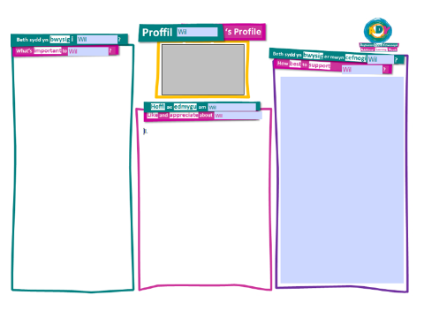
Gathering information
Like and admire
Positive
6) What do your family and friends say that they love and admire about you? (contributes to the like and admire section)
Notes:
67

Slide 68
Like and admire
For every negative element, ask three questions:
Are there circumstances where the negative element is positive?
If so, add to the appreciated things
Does the negative element reflect something that is important to the individual?
If so, add to the important to list
Is the negative element a problem at times? If so, what do other people need to know or do to support the individual when it is a negative element? Add to the Important for list
Notes:
68

Slide 69


How effective is the one page profile?
Quality one page profile
Have included What's important to ...
Have included 'What is important for ... instruction
Balance between 'important to' and 'important for'
Positive Statements
Plenty of details so that anyone can use the information immediately.
Everyday language and no jargon
Correct, clear and easy to read information
Notes:
69

Slide 70
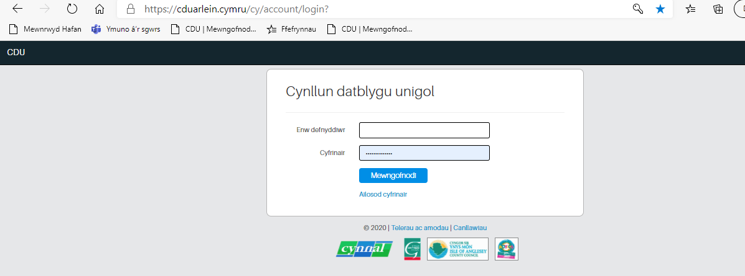

Receiving an invitation to contribute to the 1PP
Website address – save in favourite
https://cduarlein.cymru/cy/account/login?
https://www.cduarlein.cymru/Documents/System_CDU_IDP_Rhieni-Cyfranwyr%20_Parents_Contributors_24102019.pdf

Slide 71
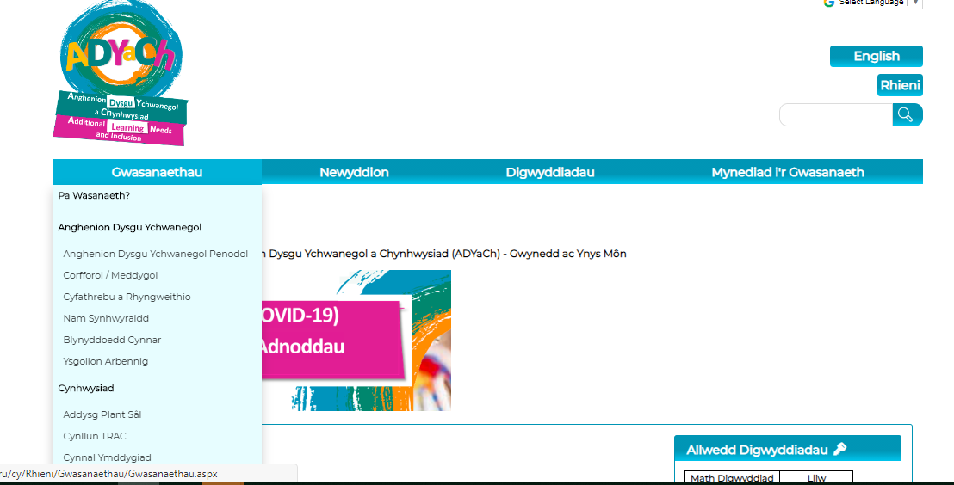
ADYaCh Gwynedd a Môn Website https://adyach.cymru
1: Click on the ‘service’ tile
2: Click on the ‘Eraly Years’ tile

Slide 72
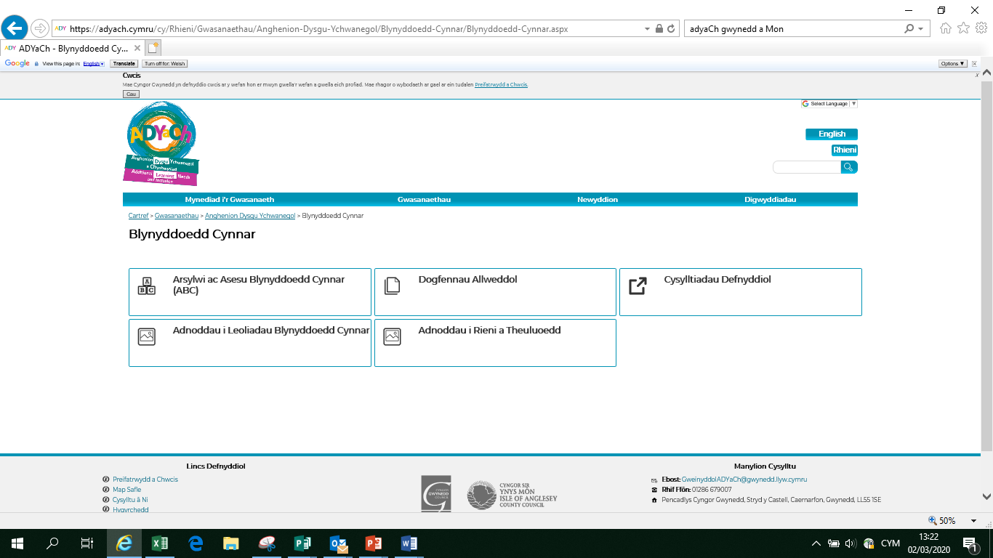
ADYaCh Gwynedd a Môn Website

Slide 73

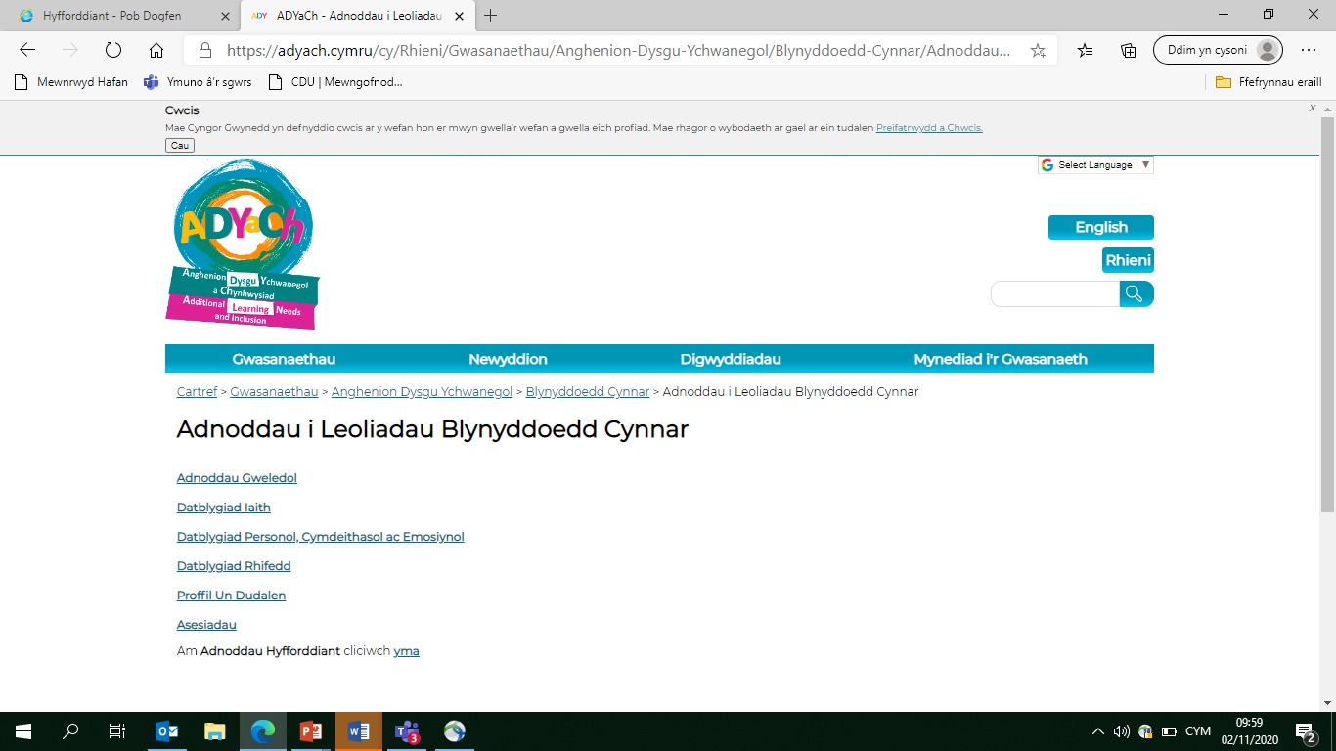
Gwefan ADYaCh Gwynedd a Môn
1: Click on the resources for Early Years settings
2: Click on the one page profile

Slide 74
Visual resources
Using pictures to support language is vitally important in helping children in the early years to -
Understand what is being said and do rather than follow others.
Accept what is being said
Cope in a situation
Not having to guess what is being said
Enjoy what's happening
Reduce anxiety level

Slide 75
Visual time table in every early years setting – Universal provision
A visual way of presenting the routine. Every setting should have a visual schedule.
Why?
Everyone thrives with routine
Structure allows them to organize their thinking and anticipate events
Set expectations in a simple way
Reduce anxiety level
Anxiety can make audio information difficult to process
How?
Laminated picture cards
Locate in a visible position
Ideally set them across (simulate the reading process)
Practitioners to use with everyone to move from one activity to another by drawing the children's attention to the picture and giving a warning e.g. 'In 2 minutes playtime finishes, THEN tidying up' (keep language very simple) A sand timer can be used. Some will need reminding using a picture on the keyring. After two minutes' Now, tidy up (point to the picture) then playtime’ and turn the card around.
An integral part of your daily practice

Slide 76
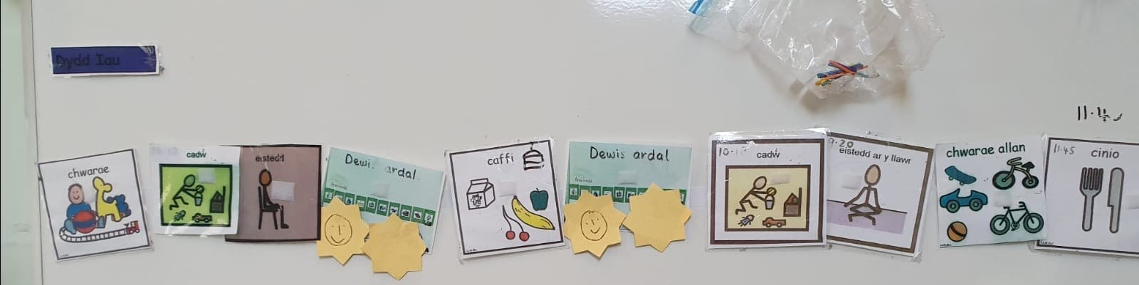
Visual time table in every early years setting – Universal provision

Slide 77


Now and Then cards- Targeted Universal provision
A visual way to support a child moving from one activity to the next
Why?
Some have difficulty moving their brains between different tasks
Help prepare the brain for the change ahead
Support the transition from one activity to the next
An effective way to reduce the time they spend in one activity
Effective approach with a child who continually insists on 'what's important to ..'
To show 'then' a reward to motivate the child to engage in an activity
How?
Laminated mini cards
Template now and Then A4
Show both pictures and point to the pictures saying
'Now' activity 1 'Then' Activity 2 'If a child goes away reinforce showing the cards again.
After completing activity 1, point to the picture and say 'activity 1' finish, now 'activity 2' It is important to start activity 2 straight away so that the child can understand the process.
Card now and then work effectively if ‘then' activity is important to….
Make consistent use of the resource

Slide 78
Resources and documents on the ADYaCh Gwynedd a Môn website
Examples of one-page profiles
The draft Provision Map
Revised ABC Tracking Profile (January 2020)
Training session resources and presentations
Links to useful ALN related websites

Slide 79
What’s Next?
Familiarise yourself with the Provision Map document and appendices
Consider when the process can begin to be implemented
Question and Answer Session
Arrange supervision sessions (with LA officers and settings) - By the end of January
Further training program developed based on your response
Training to introduce guidance for the Additional Provision (yellow) tier and Person centered approach to facilitate positive communication (Spring Term)
Code in effect from September 2021

Slide 80
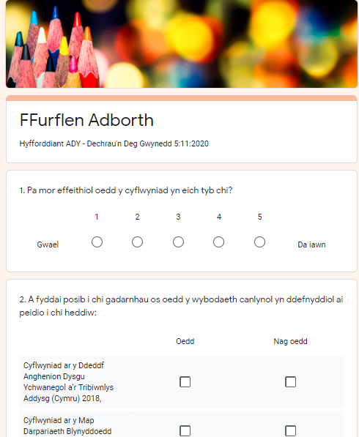

Feed Back Form
https://forms.gle/f4DT5B4S2CXZseL87
Thank You

